Slide 1

Hello
Stand On a Spot
Notes:
Get a mat that matches your spot. Put it over your spot and stand on it.

Slide 2
Safe
Notes:
Leave the spots and give everyone a safe high five and say “I travel to open spaces!”.

Slide 3
Ball
Spot
S
+
Notes:
Get a ball and a spot with your first initial and take them to an own space inside the boundaries. When you get to a safe own space, bounce your ball on your spot. Say the name of the letter on your spot each time you bounce the ball on the spot!

Slide 4
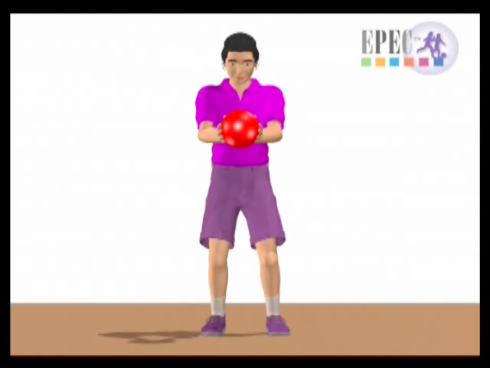
Bounce - Catch
Notes:
Bounce the ball on your spot, say the name of the letter on your spot, each time you bounce the ball on it!

Slide 5

Notes:
Stop and put the ball on the ground between your two feet.
What do you look at when you are catching the ball?
The ball
Where on the ground do you bounce the ball?
On the spot
Where is the spot?
In your own space, close to you.
Bounce the ball on as many alpha spots as you can safely, before I say stop! Say the name of the letter on the spot when you bounce the ball on the spot.

Slide 6
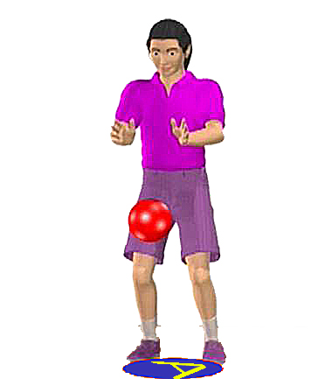

Bounce - Catch
Notes:
Bounce the ball on as many alpha spots as you can safely, before I say stop! Say the name of the letter on the spot when you bounce the ball on the spot.
While the children are playing, I will put more alpha spots out on the floor.

Slide 7
Notes:
Stop and put the ball on the ground between your two feet.

Slide 8
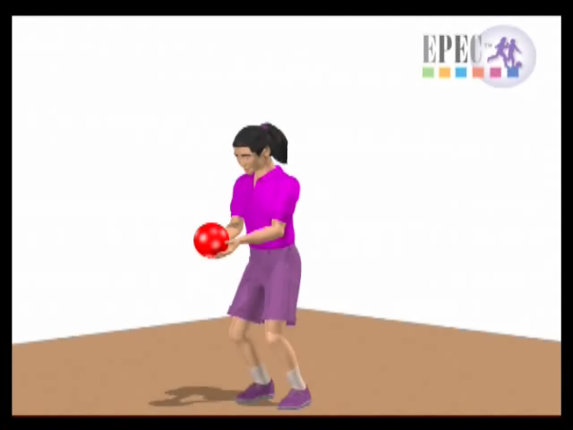
Toss - Catch
Notes:
Start on your first initial. Toss the ball to the air, when it comes back down to you, catch it!

Slide 9
Notes:
Stop and put the ball on the ground between your two feet.

Slide 10
Toss - Catch
Notes:
What do you look at when you catch the ball?
The ball.

Slide 11
Notes:
Stop and put the ball on the ground between your two feet.

Slide 12
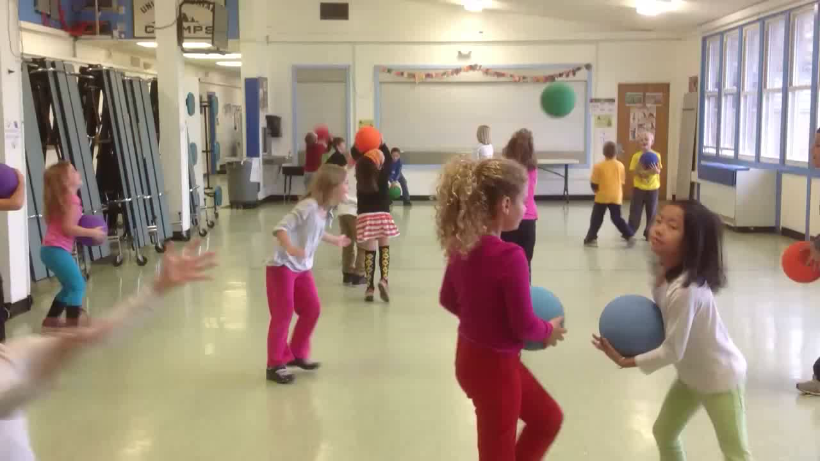
Toss - Catch
Notes:
Where on the ball, do you put your hands to make it easier to catch the ball?
The sides and slightly under the ball.
Let the students get another object to throw and catch;
Bean bag
Yarn ball
Playground ball
Etc.

Slide 13
Notes:
Stop and put the ball on the ground between your two feet.

Slide 14
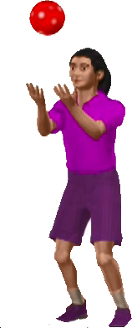
Toss & Count
1
6
2
5
3
4
Notes:
“Get a hoop that matches your ball, put your hoop in an own space, stand inside it and toss your ball up in the air and when it comes back down, catch it. It’s ok to catch it on a bounce, but try to stay in your hoop while you toss and catch.”
Toss your ball up in the air two times and then put it down between your feet.
Toss your ball up three times and then put it down between your feet.

Slide 15
Notes:
Stop and put the ball on the ground between your two feet.
After each trick, offer the option to get a different type of “ball” to throw up into the air and catch.

Slide 16

Toss & Clap
Notes:
Can you toss the ball and clap before you catch it?
• “Take your ball and travel to a new hoop the same color as your ball. When you get to your new hoop, start tossing and catching your ball again. See if you can clap before you catch the ball. Keep tossing and catching until you hear me tell you to Freeze.”
• Travel to another hoop and toss and catch your ball two (Substitute any number) times and then travel to another hoop. Keep traveling to a new hoop and tossing two times until you hear me say freeze.

Slide 17
Notes:
Stop and put the ball on the ground between your two feet.

Slide 18
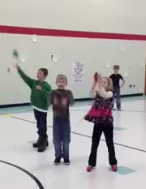
Toss & Touch

Slide 19
Notes:
Stop and put the ball on the ground between your two feet.

Slide 20
Toss & Travel

Slide 21
Notes:
Stop and put the ball on the ground between your two feet.

Slide 22
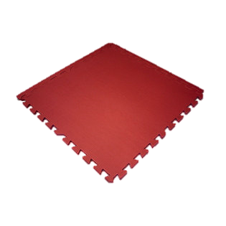
Mat
Notes:
Put away your Hoop and your ball, get a mat that matches the color of your hoop and put it in an own space.

Slide 23

STRETCH

Slide 24

STRETCH

Slide 25

STRETCH

Slide 26
REVIEW
What do you look at when you are catching the ball?
Where do you put your hands on the ball to make it easier to catch it?
What color is this screen?
Notes:
Please pick up your mat and bring it to the shed. Then I would like you to help me by picking up the cones, spots and balls and bring those over to the shed.

Slide 27
Have a fun week!

