Slide 1

Welcome
Stand on a Mat

Slide 2
SAFETY RULES
(
DO YOUR BEST
We all are different, but we all can do our own best.
BE SAFE
It’s our responsibility to keep ourselves safe.
BE RESPECTFUL
Treat people the way you want to be treated.
Treat the equipment you would want someone to treat your things.
Treat our school, gym and environment the way that you treat your home.

Slide 3
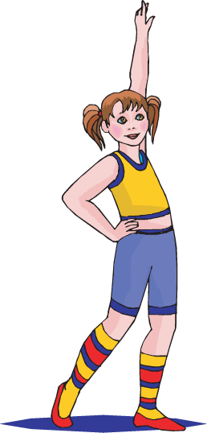
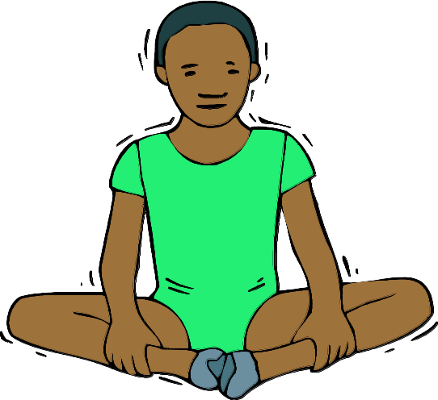
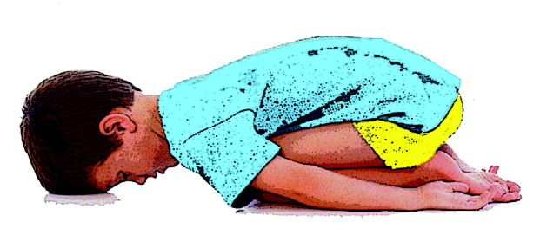
Levels Hunt
LOW
MEDIUM
HIGH
Notes:
Levels Hunt
"Underneath each mat is a card that shows you an example of one of the three levels. The card also has the name of the level written next to the picture. When the music begins, you will look under the mat you are standing on. Travel in that level to a new mat. When you get to the new mat, look under it to see what your next level is you will use when you travel. See if you can find out what is under every mat before the music stops. Keep going until the music stops.

Slide 4

Inside a Paper Bag!

Slide 5
Body Parts
Notes:
In place review of balances

Slide 6
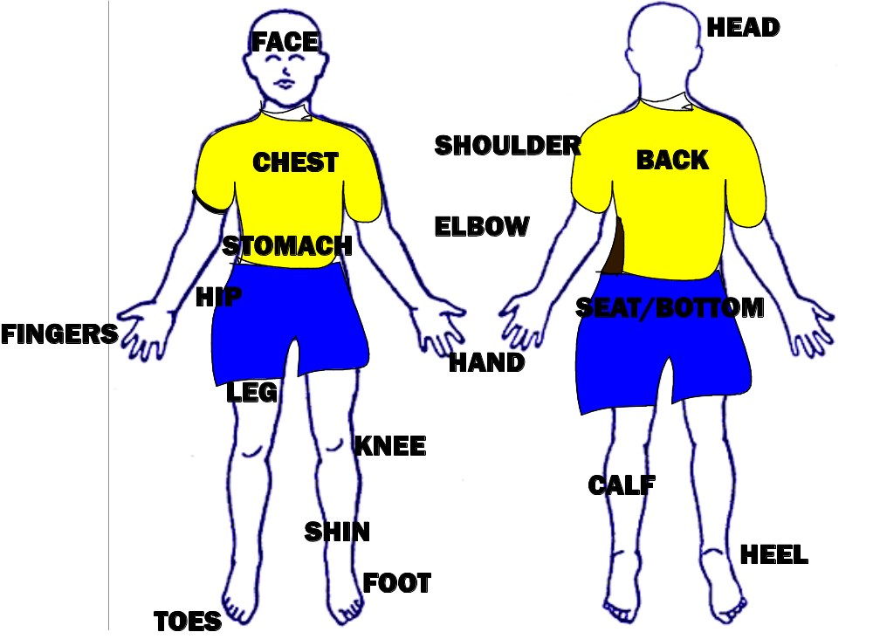
Notes:
Seated Review of Body Parts

Slide 7
BALANCE
Hold your body still for 3 or more seconds

Slide 8
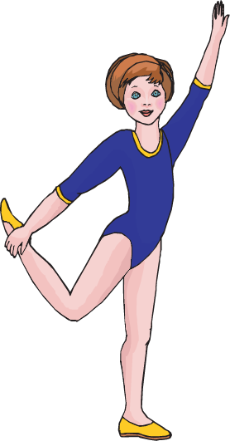
Take your weight on your:
Foot

Slide 9
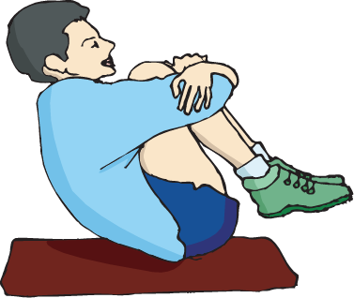
Take your weight on your:
Bottom/seat

Slide 10
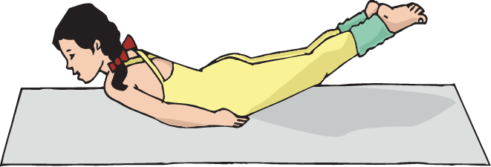
Take your weight on your:
Stomach

Slide 11
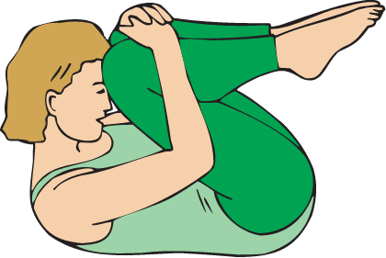
Take your weight on your:
Back

Slide 12
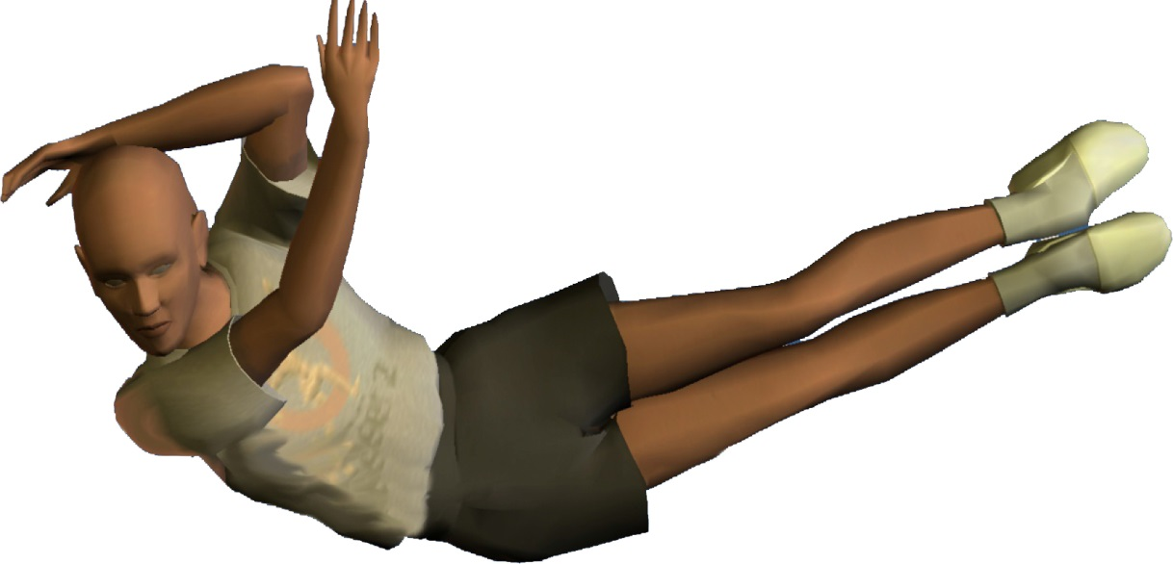
Take your weight on your:
Hip

Slide 13
Take your weight on your:
Foot

Slide 14
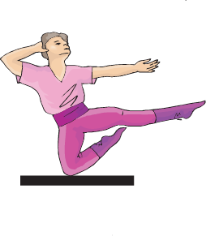
Take your weight on your:
Knee

Slide 15

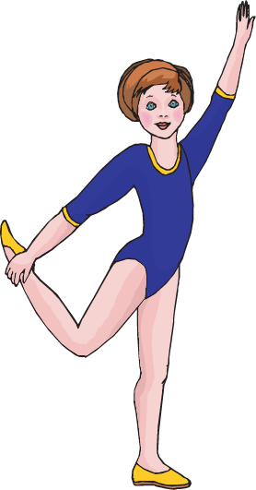
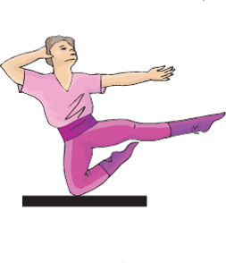



Balance

Slide 16
Travel and Balance
Notes:
Travel to a new mat and choose one body part to balance on. Hold your balance as you count to five. When you finish counting to five you can relax on your mat.
Do this at least 3 times

Slide 17




Low Level
Travel and Balance
Notes:
This time, travel to a new mat using a low level when you get there choose one body part to balance on.

Slide 18
Medium Level
Travel and Balance
Notes:
This time, travel to a new mat using a low level when you get there choose one body part to balance on.

Slide 19
High Level
Travel and Balance
Notes:
This time, travel to a new mat using a low level when you get there choose one body part to balance on.

Slide 20
Balance, Travel and Balance
Notes:
Balance on one body part, hold it for a count of five. Travel to a new mat using any level you would like. When you get to the new mat, balance on a different single body part. After you hold the second balance for a count of five you can relax on your mat.
Do this at least three times.

Slide 21
Balance, Travel, Balance, Travel and Balance
Notes:
Balance on one body part, hold it for a count of five. Travel to a new mat using any level you would like. When you get to the new mat, balance on a different single body part. After you hold the second balance for 5 seconds travel to a new mat and Balance on a different single body parts! After you hold the Third balance for a count of five you can relax on your mat.
Do this at least three times.

Slide 22
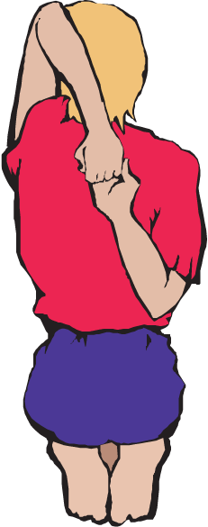
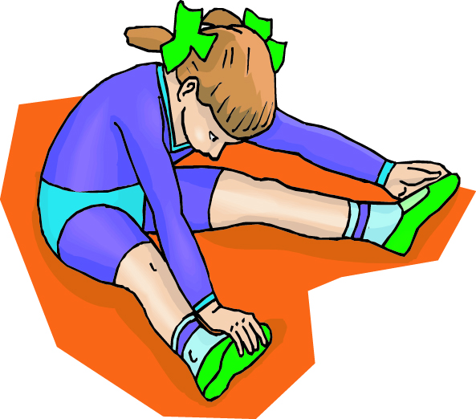
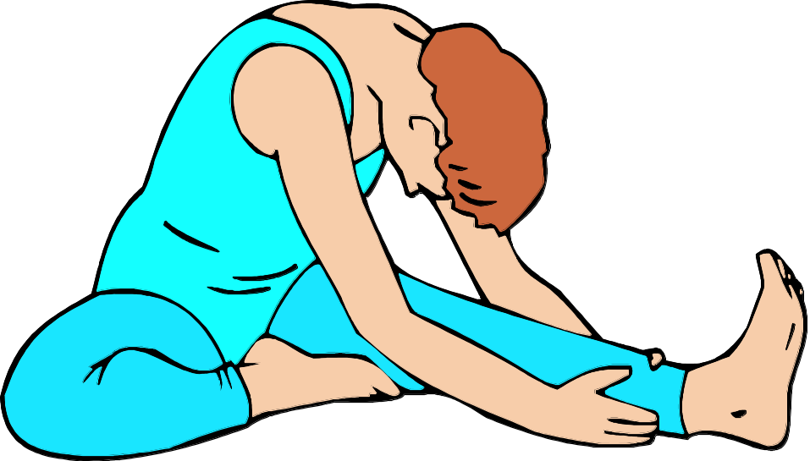
STRETCH

Slide 23
Closure
Name one body part you balanced on today.
What is balancing?
Holding your body still for 3 or more seconds

