Slide 1

Welcome
Stand on a Mat

Slide 2
DO YOUR BEST
BE SAFE
BE RESPECTFUL

Slide 3
Body Parts

Slide 4
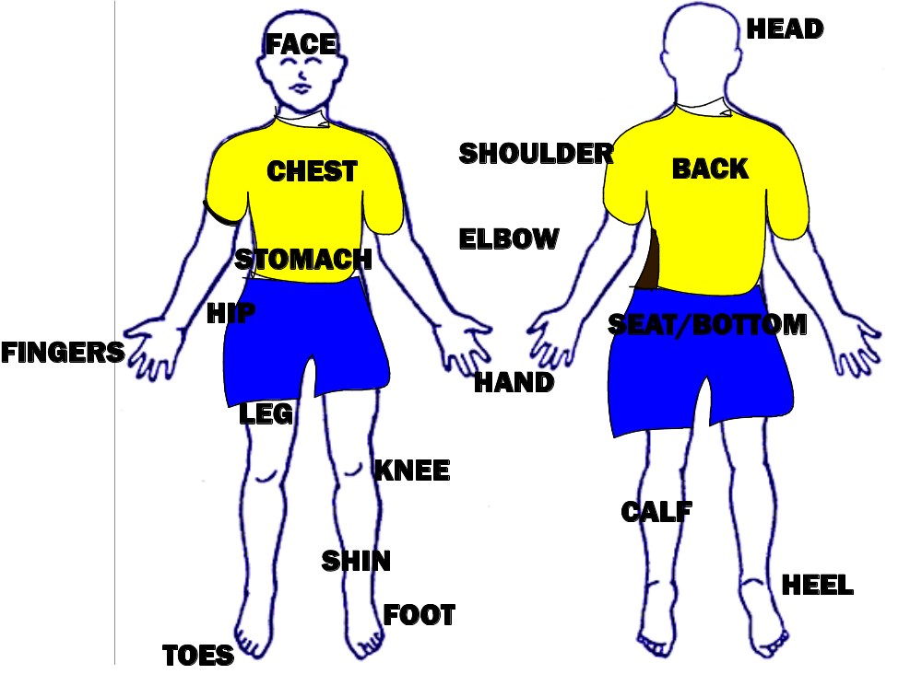

Slide 5
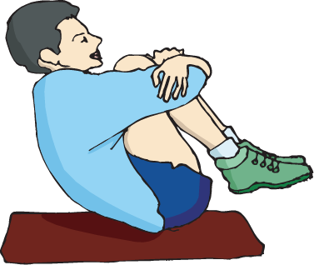
Take your weight on your:
Bottom/seat
Notes:
Review the balances on one body part.

Slide 6
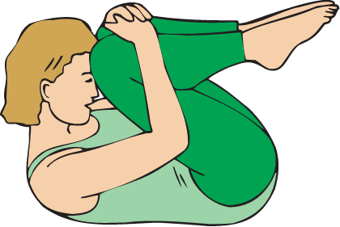
Take your weight on your:
Back

Slide 7
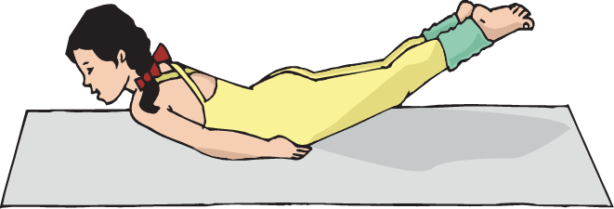
Take your weight on your:
Stomach

Slide 8
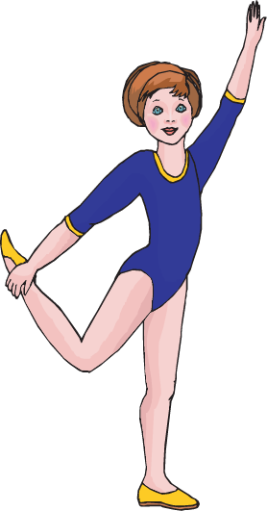
Take your weight on your:
Foot

Slide 9
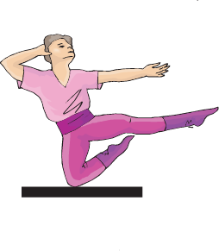
Take your weight on your:
Knee

Slide 10
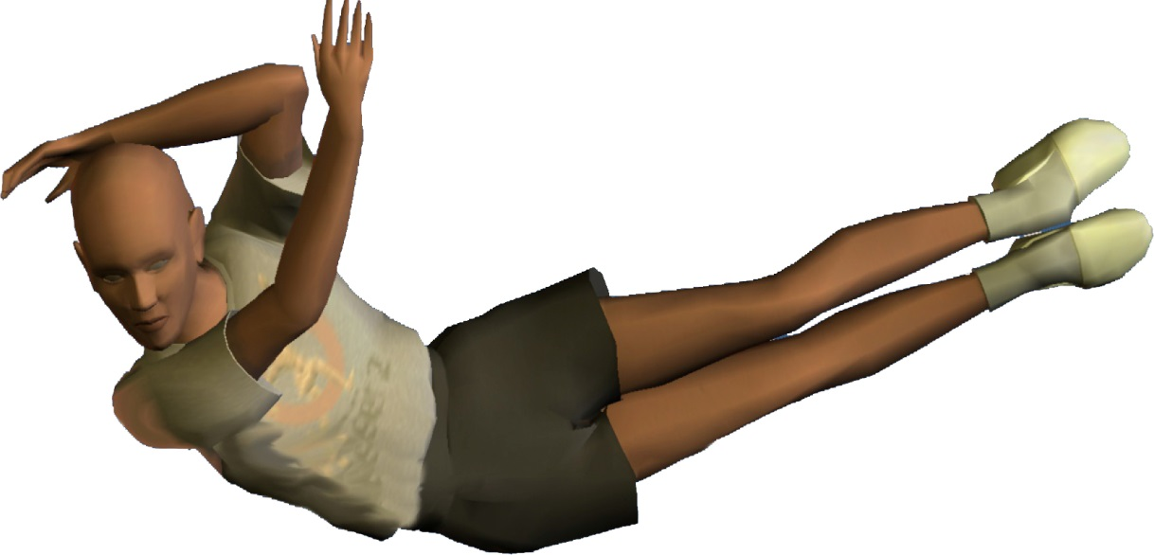
Take your weight on your:
Hip

Slide 11

Musical Balance
Notes:
Musical Balance
Music Track: Travel & Balance on ONE Body Part
Each mat has a balance card by or under it. When the music begins, the children will travel around in the designated level or direction that you have told them to use, avoiding the cones and mats. When the music stops the children will be directed to find a mat and balance on one body part. The children then go to the mat closest to them and do the balance on the card, until the music begins again! Try to get to as many different mats as you can before the song is over.

Slide 12



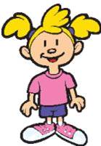
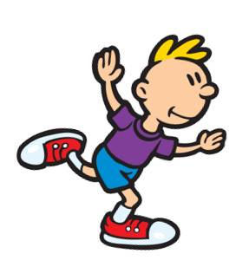
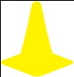
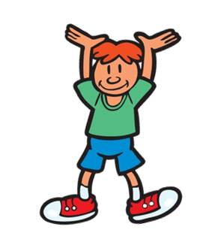

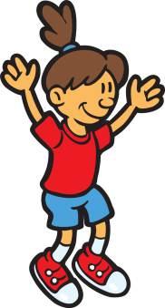
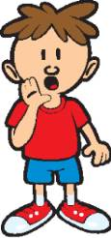
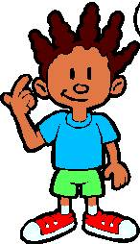
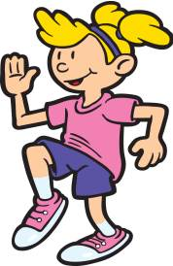
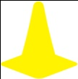


Notes:
Alternate back and forth between this slide and the balance slide. When the music is playing show this travel slide. When the music stops change it to the balance slide. The music will play until the song is over.

Slide 13
BALANCE
Hold your body still for 3 or more seconds

Slide 14
Stand on a Mat
Notes:
Take this time to explain that they will be balancing on 4 parts today. There are many balances that you can do on 4 body parts.

Slide 15
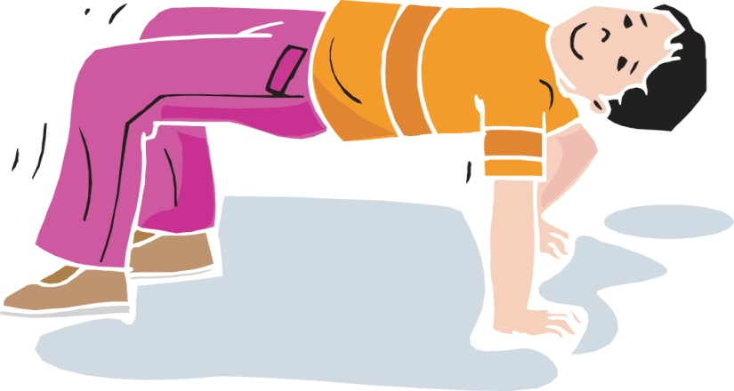
BALANCE ON 4 BODY PARTS
Take your weight on two hands and two feet.
Two (2) hands + Two (2) Feet =
Four (4) Parts
Notes:
Try this balance. What’s another shape you can make with your body, but still balance on your two hands and two feet?

Slide 16
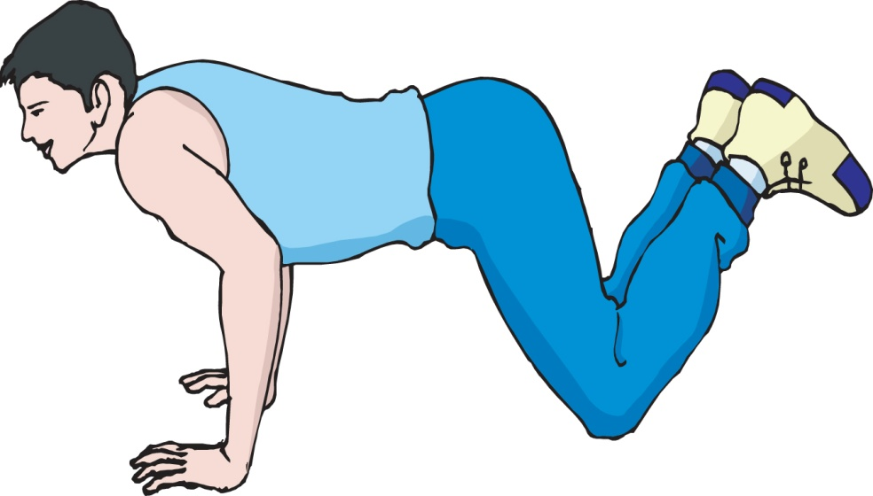
BALANCE ON 4 BODY PARTS
Take your weight on two hands and two knees.
Two (2) hands + Two (2) Knees = Four (4) Parts
Notes:
What’s another shape you can make, but still balance on your hands and knees?

Slide 17
BALANCE ON 4 BODY PARTS
Take your weight on two elbows and two knees.
Two (2) Elbows + Two (2) Knees = Four (4) Parts

Slide 18
BALANCE ON 4 BODY PARTS
Take your weight on two hands, one foot and one knee.
Two (2)Hands + One (1)Foot + One (1)Knee = Four (4) Parts

Slide 19
BALANCE ON 4 BODY PARTS
Take your weight on your head, two feet and one hand.
Head (1) + Two (2) Feet + One (1) Hand = Four 4 Parts

Slide 20
Practice
Choose four parts to balance on. Choose a different combination of parts than the ones we used as a class.

Slide 21
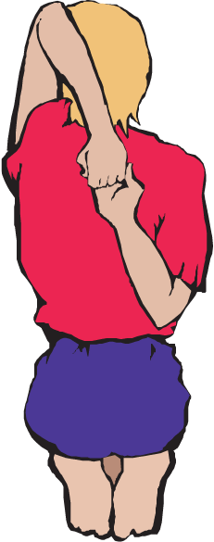
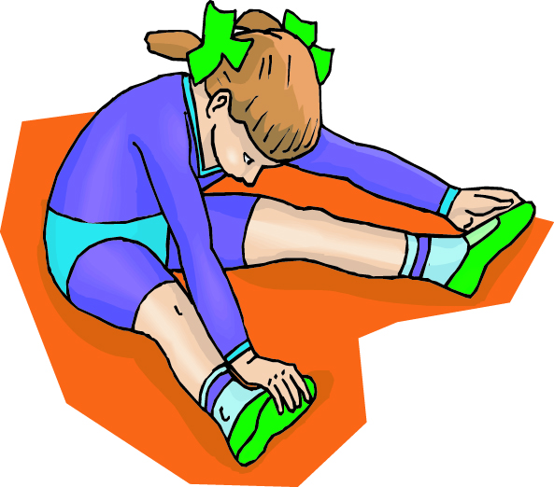
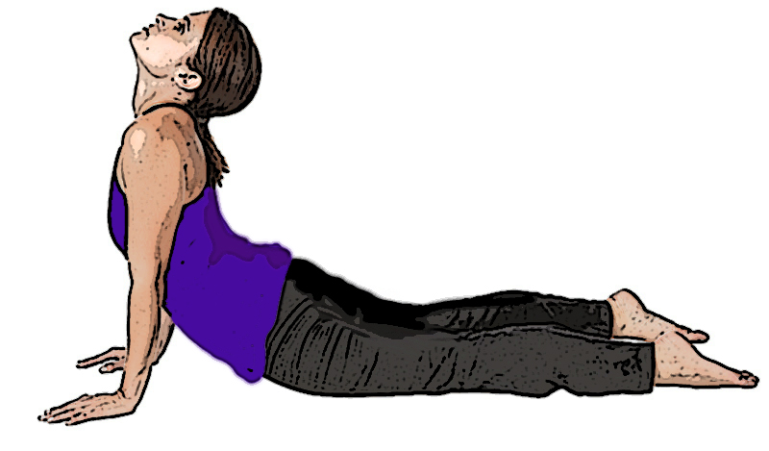
STRETCH

Slide 22
Closure
Describe one of your balances to a partner.

