Slide 1

WELCOME
Get a Bean Bag
Stand on a Spot that matches
Toss & Catch

Slide 2
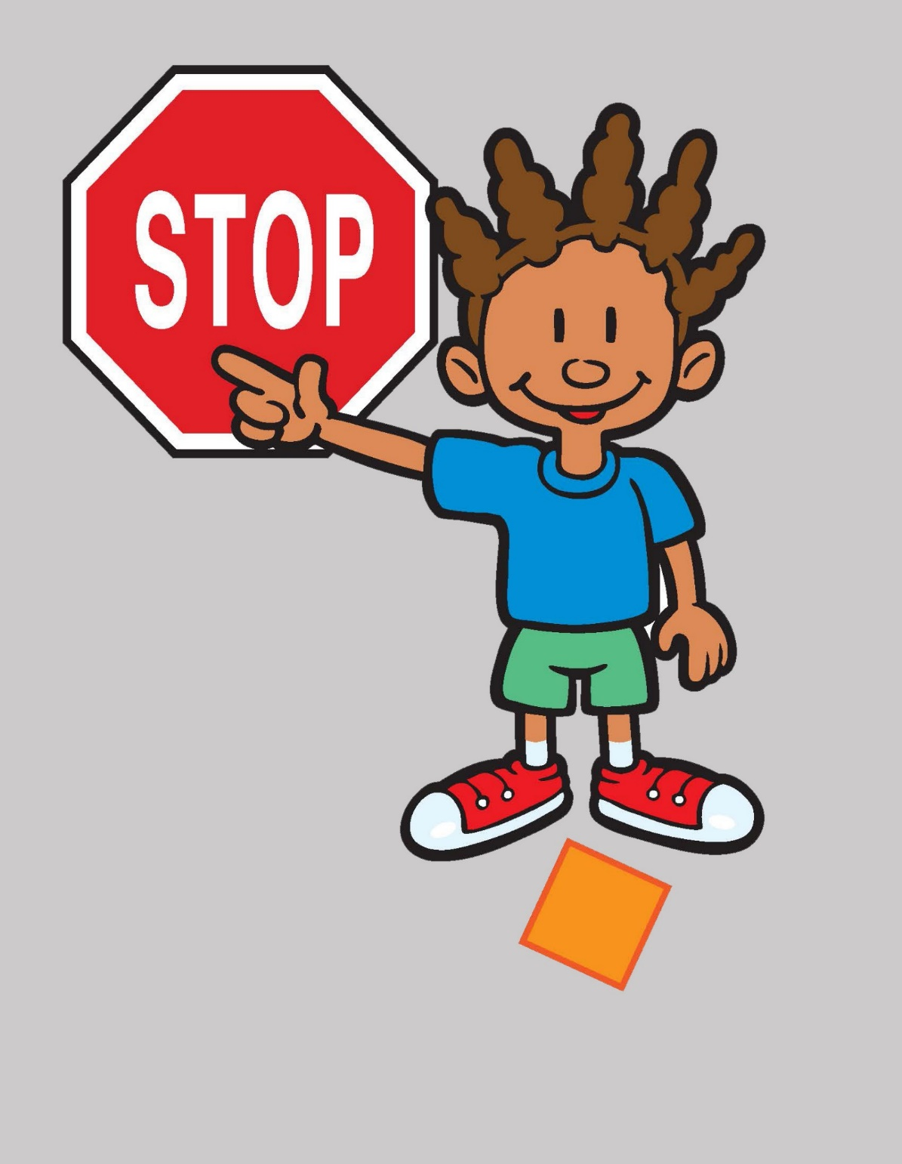

Slide 3
Frozen Bean Bag

Slide 4
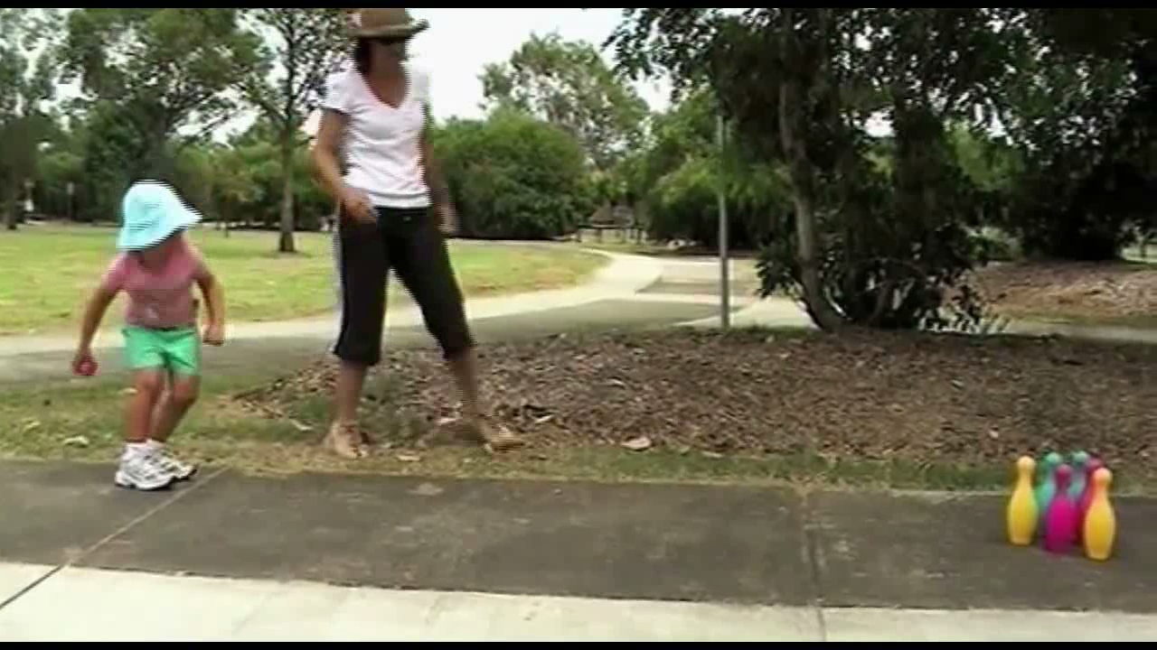
ROLL THE BALL
Notes:
Put your bean bag in a hoop.
Get a Ball and a Target that match

Slide 5
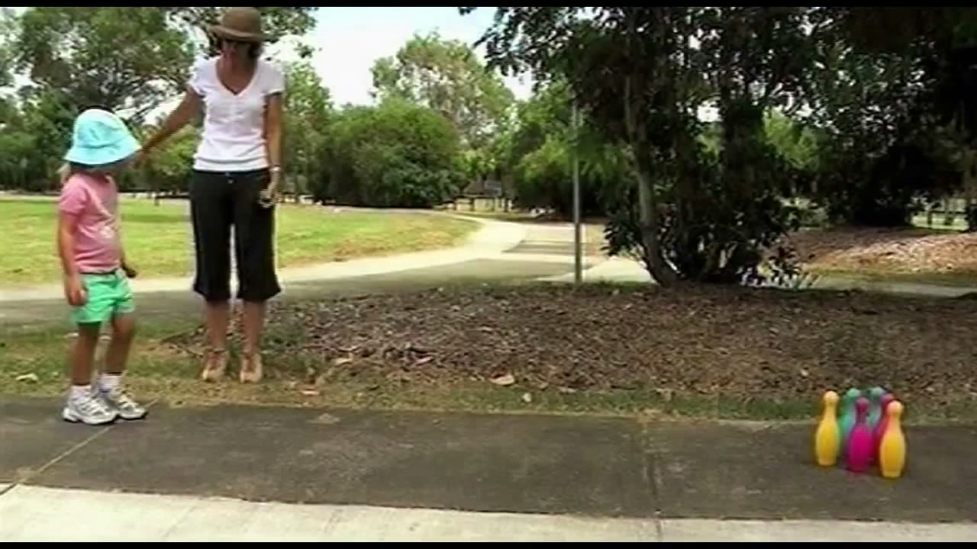

Underhand ROLL the BALL and knock down the TARGET

Slide 6

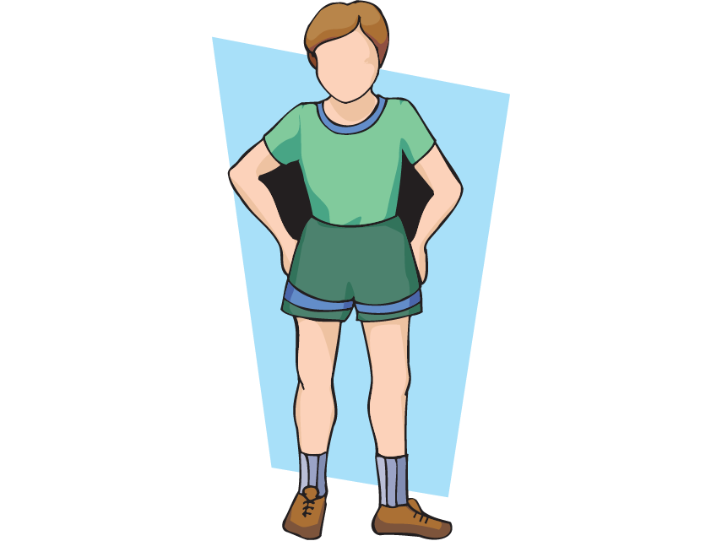

Slide 7
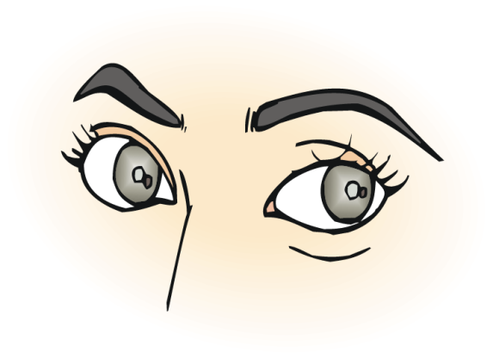
What is the BEST
thing to look at
when you are ROLLING
the BALL at the TARGET?
Notes:
If you look at this; it will help you catch the ball

Slide 8
look at
the TARGET
Notes:
You always look at the object or thing you are trying to catch. If you don’t know where the ball is, you won’t be able to catch it as easily.

Slide 9
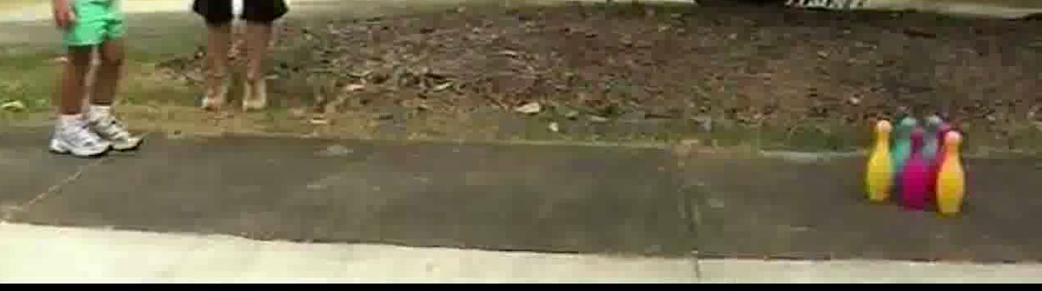
What should your weak leg step toward when you throw?

Slide 10
Weak Leg steps toward the TARGET!
Notes:
H

Slide 11
What should you swing your throwing arm toward?

Slide 12
Swing your arm toward the TARGET.

Slide 13
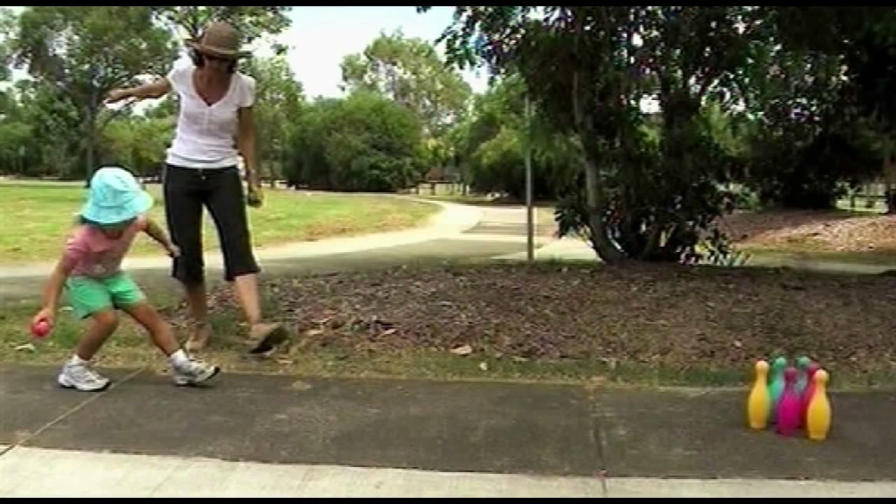
During your arm swing, when do you let go of the ball?

Slide 14
Let go of the ball just in front of your weak foot, close to the ground.

Slide 15
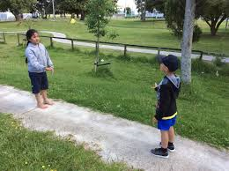

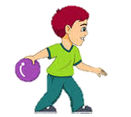


Partner Roll
Roll the ball back and forth through the two cones.

Slide 16
Stretch

Slide 17
Closure
What do you look at when you are rolling the ball?
(The Target)
What do you swing your arm toward as you roll the ball?
(The Target/hoop)
What does your weak leg step toward when you roll the ball?
(The Target/hoop)

