Slide 1
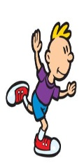
Stand On a Spot

Slide 2
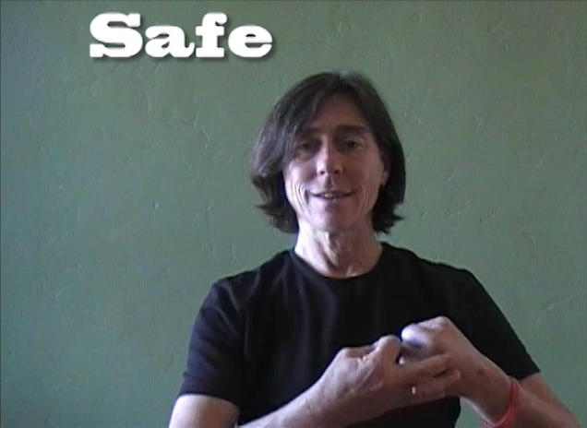
Safe
Notes:
Listen
Look for Open Spaces
Be Aware of others as you travel
Leave the Mats and give everyone a safe high five and say “I’M SAFE!”.

Slide 3

Color Hunt

Slide 4
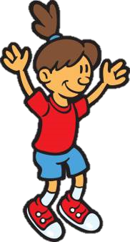
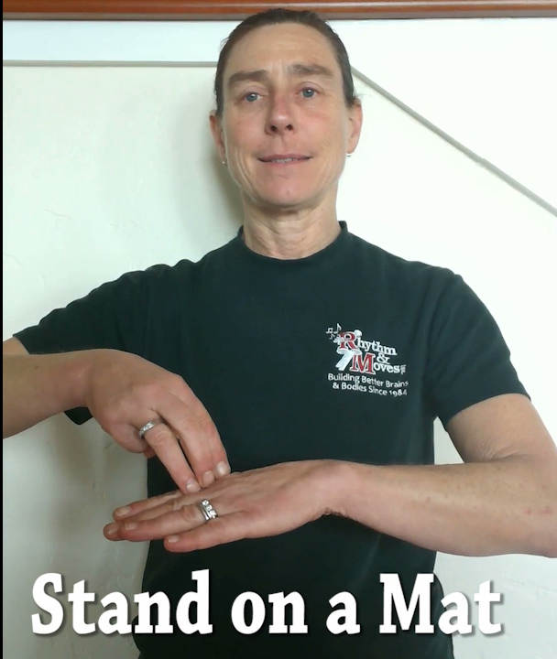
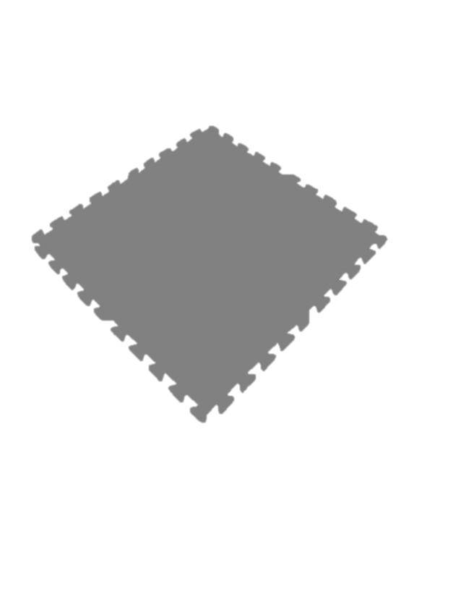
Stand on a Mat
Notes:
Get a mat that matches your spot. Put it over your spot and stand on it.

Slide 5
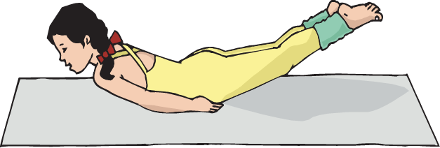
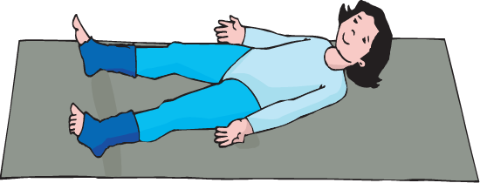
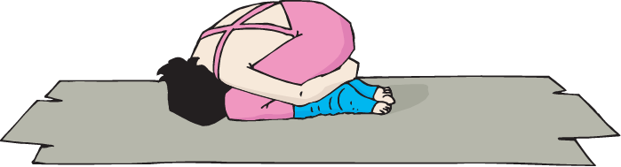
Low Level
Notes:
“Find an own space and put your whole body very close to the ground, as close as you can.”
• After your children have all found an own space and are very close to the ground, you can point out some of the shapes you see, and the fact that they are soooo close to the ground.
• “Wow! Can you find another shape to put your body in and stay close to the ground? Once the children are all in a new low level shape; “This is called being in a low level, when your body is very close to the ground it is in a low level in relation to the ground.“
• Go to another own space and fi nd another way to put your body in a low level.” Again, as your children are all getting to their new own space, be sure to point out the cool shapes you see in the low level. Continue to do this a few more times, until all your children are consistently creating shapes in a low level.

Slide 6
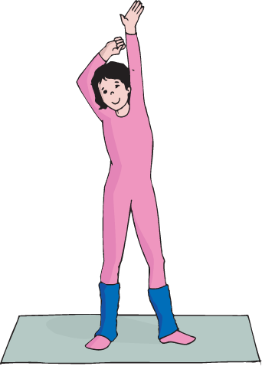
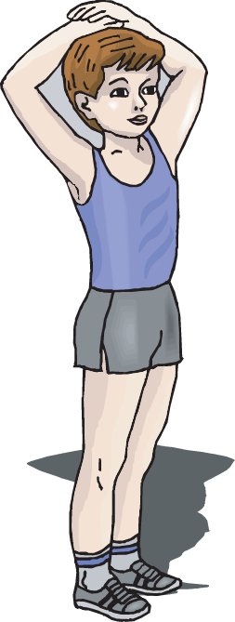
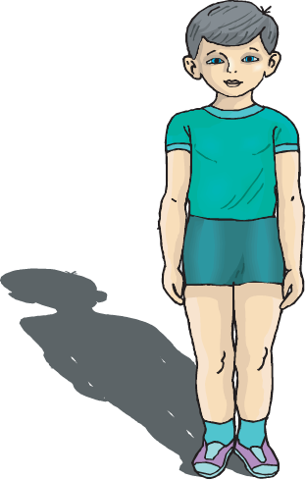
High Level
Notes:
”This time find another own space and put your body as far away from the ground as you can without flying!” Walk around pointing out how far away from the ground they are, and emphasize the various shapes you see now.
• “Go to another own space and find another shape to put your body in as far away from the ground as you can. This is the opposite of being in a low level, it is called a High level
• Go to another own space and make a new shape with your body in a high level.” Show off a shape or two as you walk around, or choose a couple children to show their shape while the whole class relaxes to watch. This will build up the self esteem of the children chosen, as well as give some great ideas to the other children. Continue to do this a few more times, until all your children are consistently creating shapes in a High level.

Slide 7
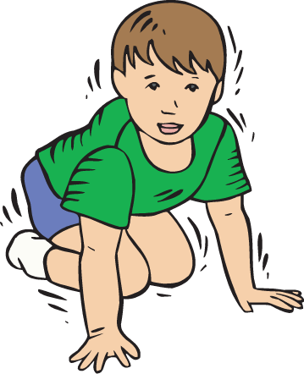
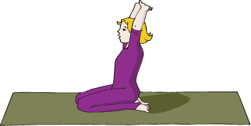
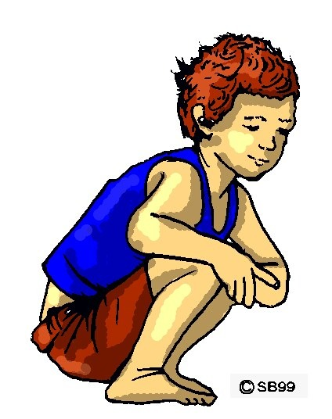
Medium Level
Notes:
”Find a new own space and put your body in a shape that is in between a low level and a high level. This is called a medium level.”
• There are a lot of chances for variety in this level. It is important to make sure your children understand the concept and do not mistake low or high for this level.
• Let them try going to at least 3 or 4 more own spaces, trying different shapes in medium levels before moving onto practice activities.

Slide 8
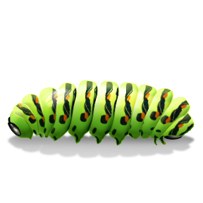
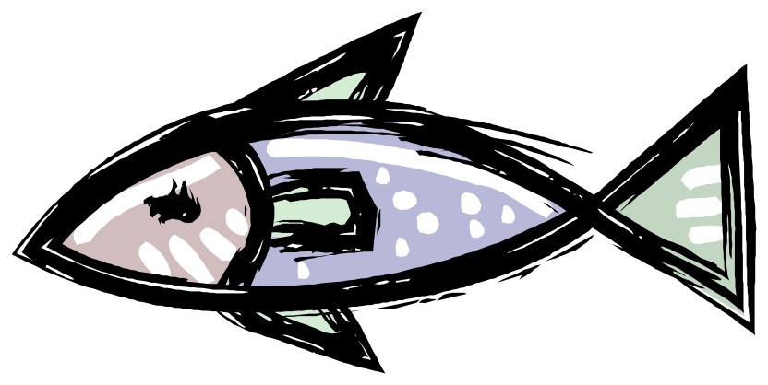
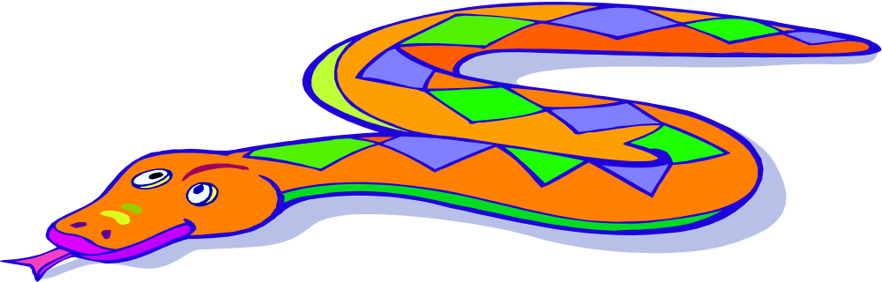
Low Level
Notes:
Traveling These are all different animals that travel in a low level. Show me how you can travel in a low level!

Slide 9
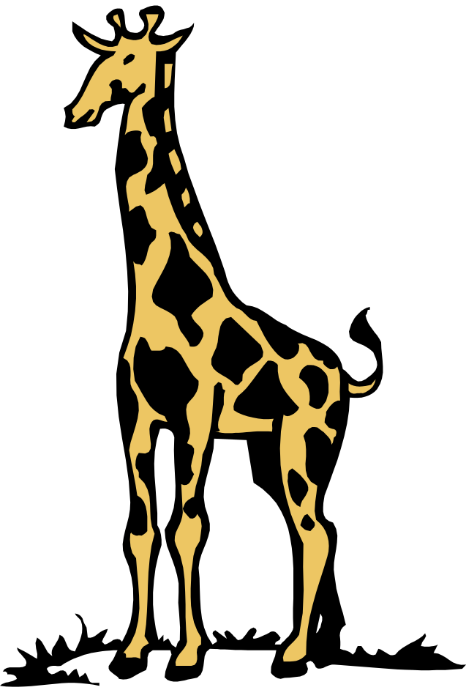
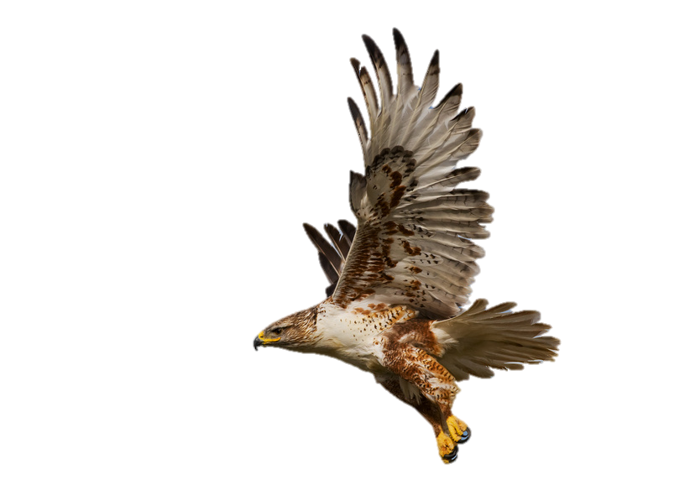
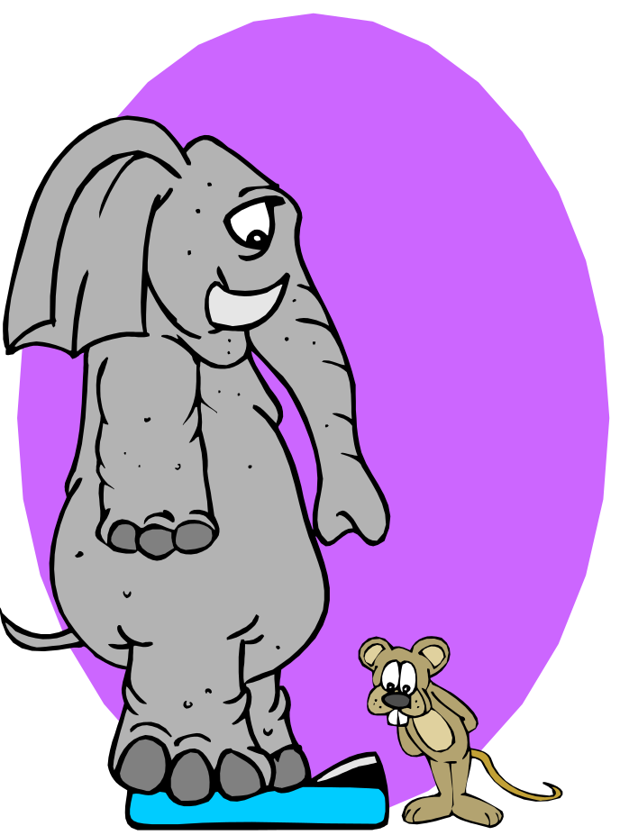
High Level
Notes:
Traveling These are all different animals that travel in a high level. Show me how you can travel in a high level!

Slide 10

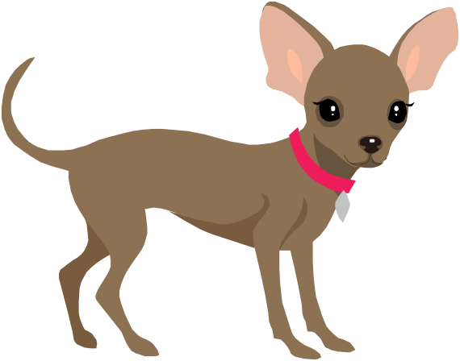

Medium Level
Notes:
these are all different animals that travel in a medium level. Show me how you can travel in a medium level!

Slide 11

Animal Action
Notes:
Listen While Moving
(Basic activity that expands awareness/proficiency of a new skill)
Listen to the song to hear which animal you are going to travel like.
As the children travel, ask them what level they are traveling in.

Slide 12
Elephant

Slide 13
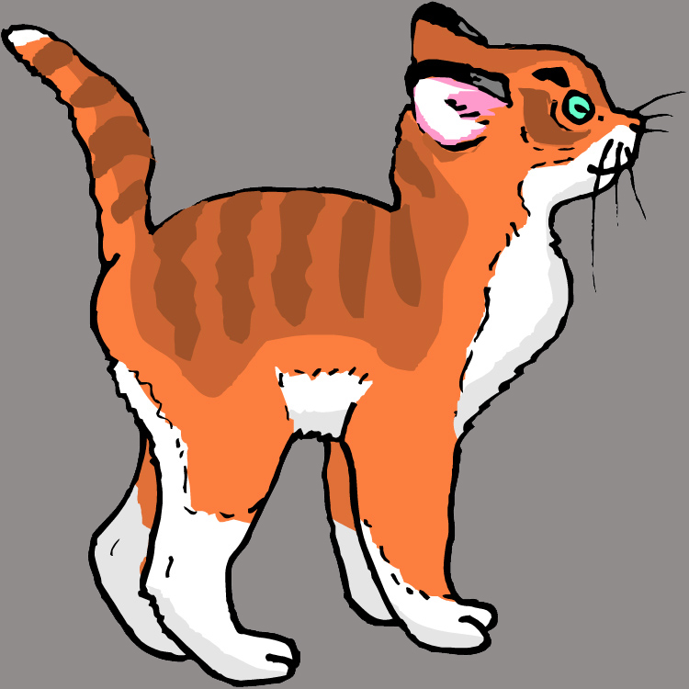
Cat

Slide 14
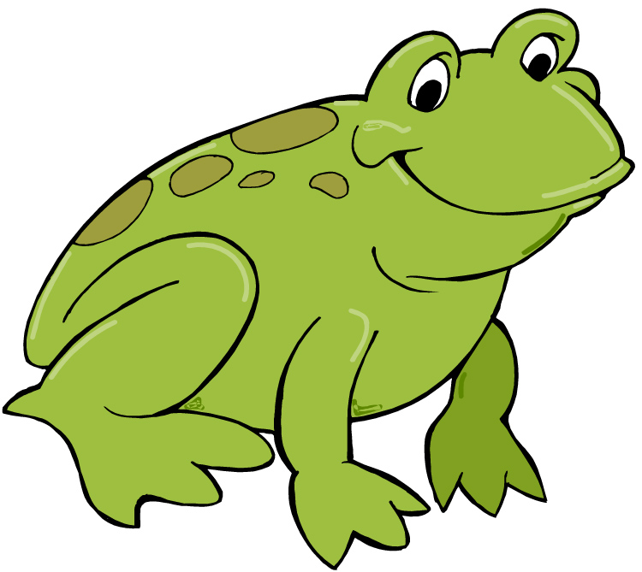
Frog

Slide 15
Bird

Slide 16
Snake

Slide 17
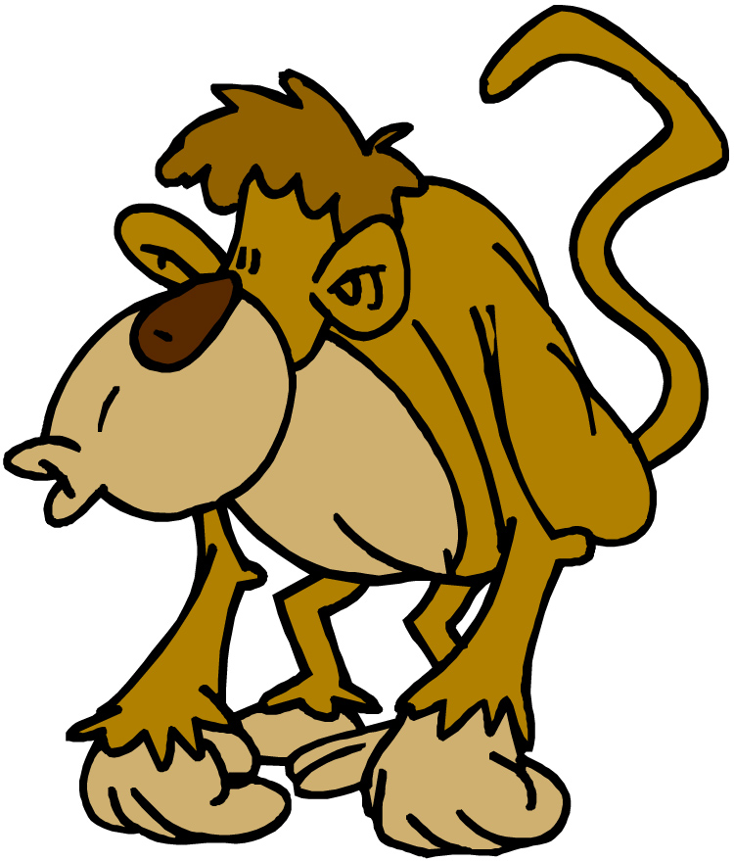
Monkey

Slide 18
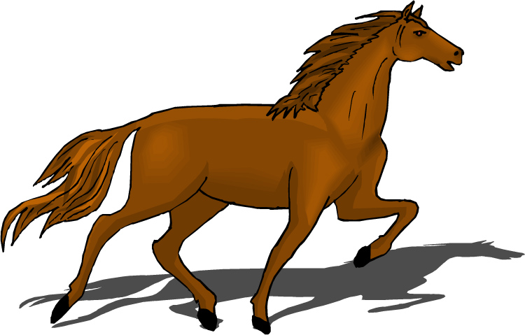
Horse

Slide 19
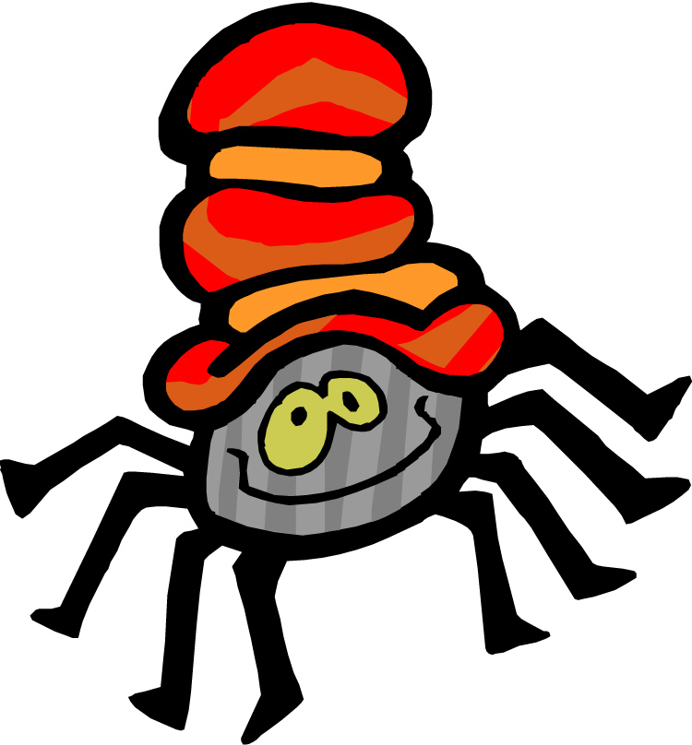
Spider

Slide 20
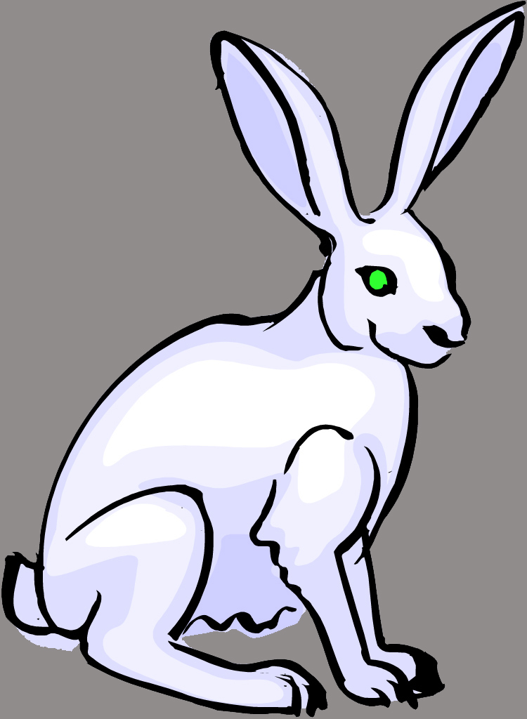
Bunny

Slide 21
Lion

Slide 22
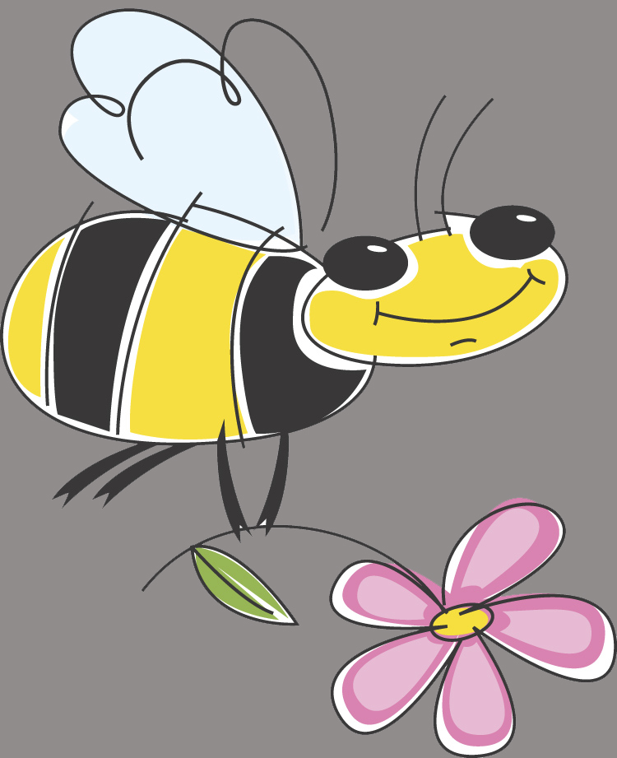
Bee

Slide 23

Duck

Slide 24
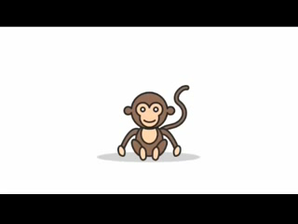
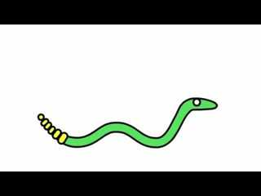
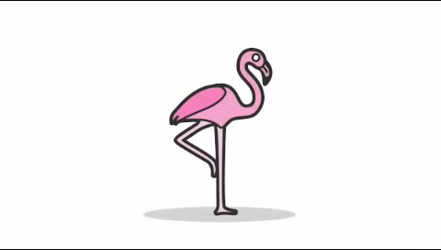
STRETCH

Slide 25
REVIEW
What was one level you traveled in today?
Notes:
What do you do when you hear stop or freeze? (Stop and look for Ms Boggs.)
Where is it safe to travel? (Inside our boundaries)
When I hold up the color card, I want you all to say the color name out loud. Ready, (Hold the card up and let the students call out the color.)

Slide 26
Good-Bye

