Slide 1
Hello

Slide 2
Safe
Notes:
Leave the spots and give everyone a safe high five and say “I’M SAFE!”.

Slide 3
Color Spots
Yellow
Notes:
When the music starts, you can look under your spot to see which color to go to next! When the music stops, freeze where ever you are and look at me.
Use this time to assess the student's ability to identify color and to verbalize the color.

Slide 4

Color Hunt
Notes:
Example of what to do!

Slide 5

GO

Slide 6


Slide 7
GO

Slide 9
GO

Slide 10
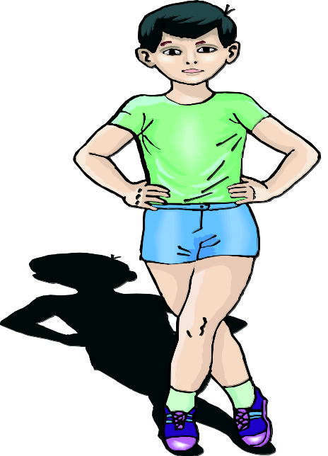
Own Space
Notes:
Get a mat that matches the spot you are on and put it in an own space. When you are in your own space, Stand on your mat.

Slide 11
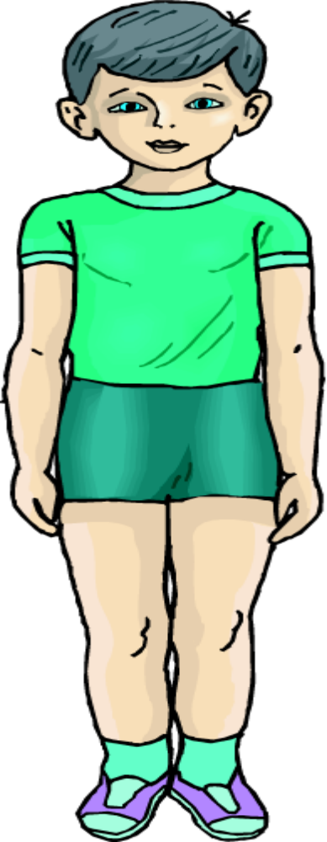
Front
FACE
CHEST
PECTORALIS
STOMACH
ABDOMEN
THIGH
QUADRICEP
KNEE
PATELLA
SHIN
TIBIALIS
TOES
PHILANGES
Notes:
Do you remember where you saw this before? that's right! when we were working on Directions. This is the front of the body. it is called the Front Surface.
Review the body parts that are on the front surface.

Slide 12
Front

Slide 13
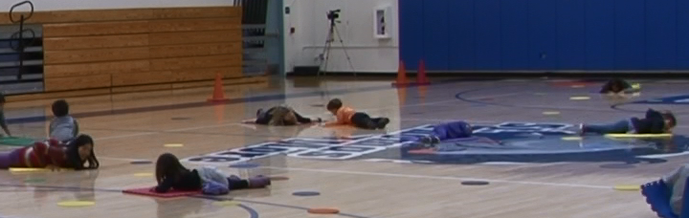
Front
Notes:
stay on your mat and make a shape on your front surface.

Slide 14
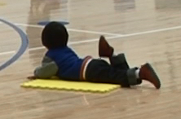
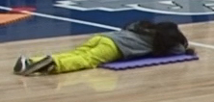
Front
Notes:
what is another shape you can make on your front surface?
Do this a couple times,
Travel to a new mat and make a shape on your front surface.

Slide 15
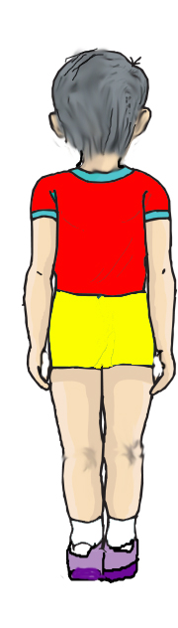
Back
Head
Back
Trapezius
Seat
Gluteus
THIGH
Hamstrings
Calves
Gastrocnemius
Heel
Notes:
Here is the Back Surface
Review the body parts on the back surface with the students.

Slide 16
Back

Slide 17
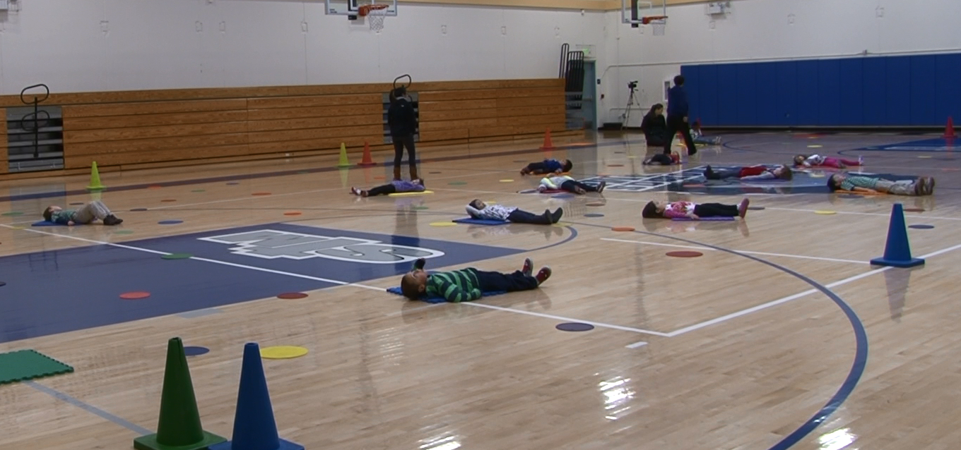
Back
Notes:
stay on your mat and make a shape on your back surface

Slide 18
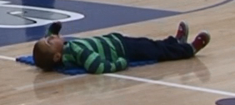
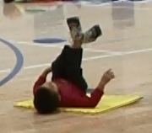
Back
Notes:
what is another shape you can make on your back surface?
Do this a couple times,
Travel to a new mat and make a shape on your back surface.

Slide 19
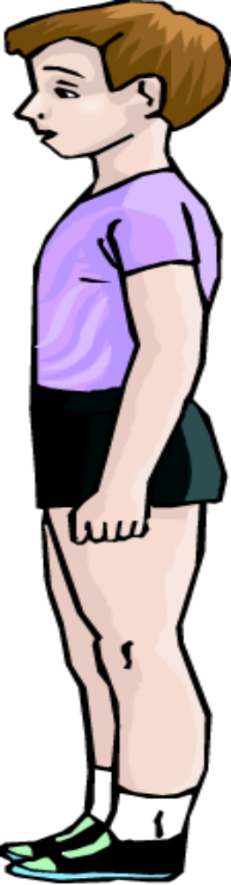
Side
Shoulder
Deltoid
Ear
Elbow
Hip
Ankle
Notes:
Which surface is this? That's right, the side surface.
Review the body parts on the side surface of the body.

Slide 20
Side

Slide 21
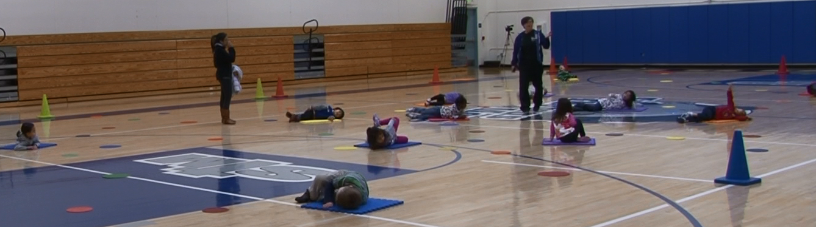
Side
Notes:
Make a shape on your side surface.

Slide 22
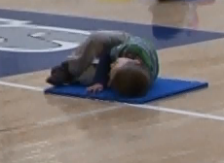
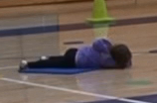
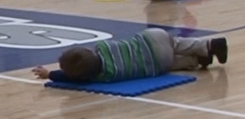
Side
Notes:
what is another shape you can make on your side surface?
Do this a couple times,
Travel to a new mat and make a shape on your side surface.

Slide 23
Body Shapes
Notes:
Listen and watch to see which body surface to make a shape on. Each time I say go, find a new mat to make a shape on.
Each time you put a new slide up, say go. the children will move from mat to mat, making different shapes on the different body surfaces.

Slide 24
Side

Slide 25
Front

Slide 26
Side

Slide 27
Back

Slide 28
Front

Slide 29
Back

Slide 30
Side

Slide 31
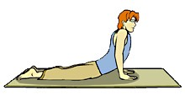
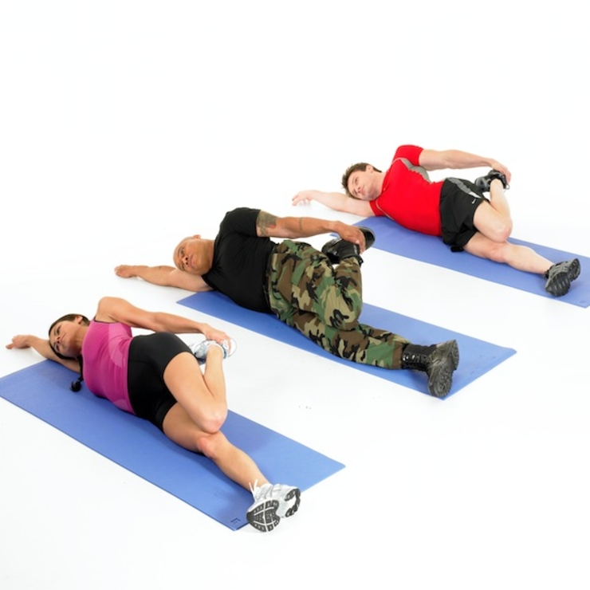
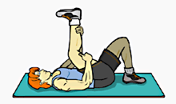
STRETCH

Slide 32
REVIEW
What body surfaces did you make shapes on today?
Front, Back & Side
Notes:
What do you do when you hear stop or freeze? (Stop and look for Ms Boggs.)
Where is it safe to travel? (Inside our boundaries)
When I hold up the color card, I want you all to say the color name out loud. Ready, (Hold the card up and let the students call out the color.)

Slide 33
Good-Bye

