Slide 1

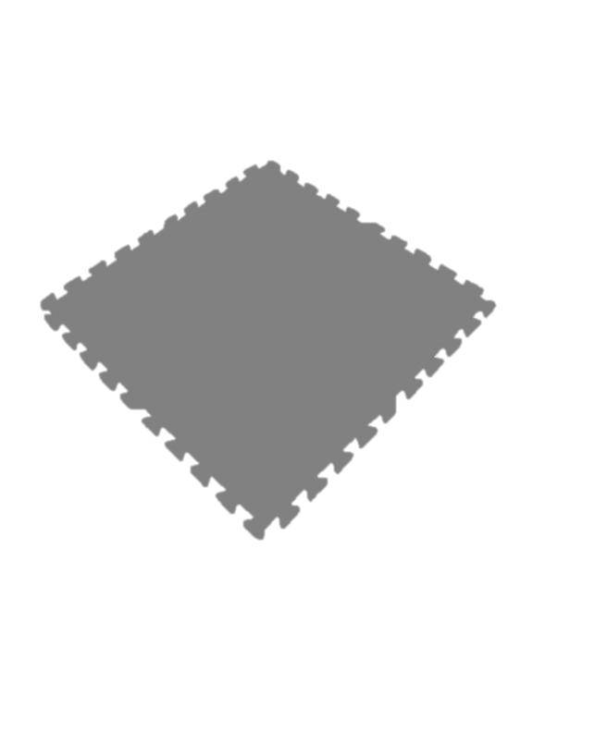
Hello
Stand on a Mat
Notes:
Get a mat that matches your spot. Put it over your spot and stand on it.

Slide 2
Safe
Notes:
Listen
Look for Open Spaces
Be Aware of others as you travel
Leave the Mats and give everyone a safe high five and say “I’M SAFE!”.

Slide 3
Levels Hunt
Notes:
Review how to play the game with the students. Travel to each new mat using the level that you find under the mat.

Slide 4
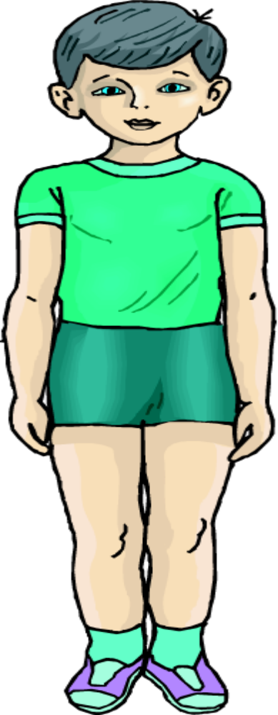
Front
FACE
CHEST
PECTORALIS
STOMACH
ABDOMEN
THIGH
QUADRICEP
KNEE
PATELLA
SHIN
TIBIALIS
TOES
PHILANGES
Notes:
Which Body Parts are on the front?

Slide 5
Front

Slide 6
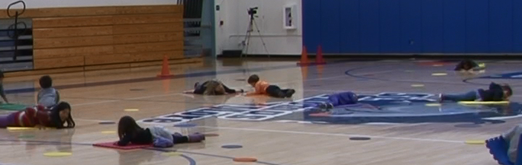
Front
Notes:
Make a shape on your front surface.

Slide 7
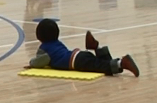
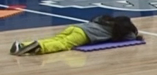
Front
Notes:
Travel to a new mat and make a shape with the front of your body facing the mat.

Slide 8



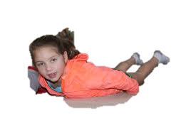


Front
Notes:
Travel to a new mat and make a new shape on your front surface! Do this at least three times.

Slide 9
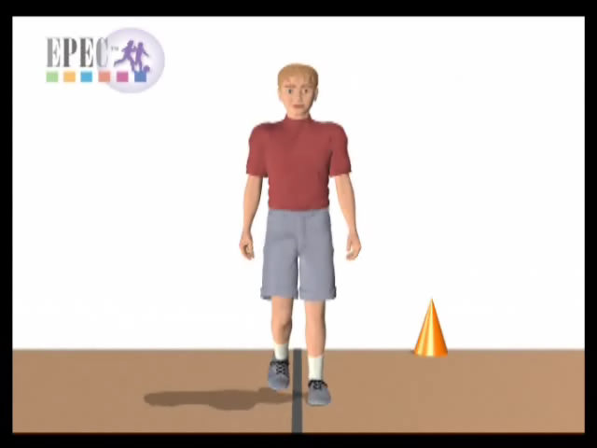
Forward Direction Front First
Notes:
When you travel so the front of your body leads or goes first, it is called “Frontwards or Forward”
What is another way you can travel forward?
Give them at least three or four tries to travel forward, thinking of a new way each time.

Slide 10
Forward - Walk
Notes:
When you travel so the front of your body leads or goes first, it is called “Frontwards or Forward”
This is forward walking! Show me how you can walk forward.

Slide 11
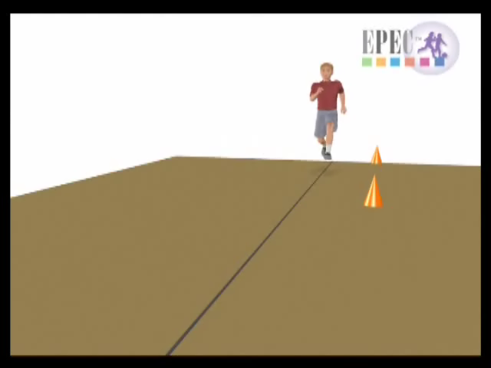
Forward - Run

Slide 12
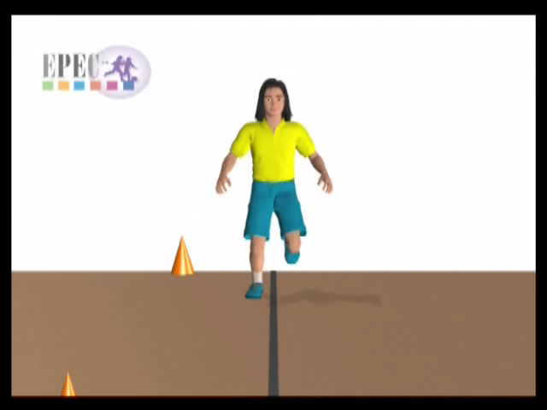
Forward - Hop
Notes:
Forward Hopping.

Slide 13
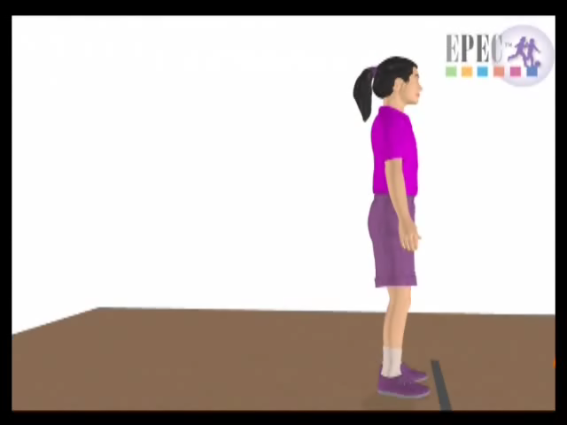
Forward - Jump

Slide 14
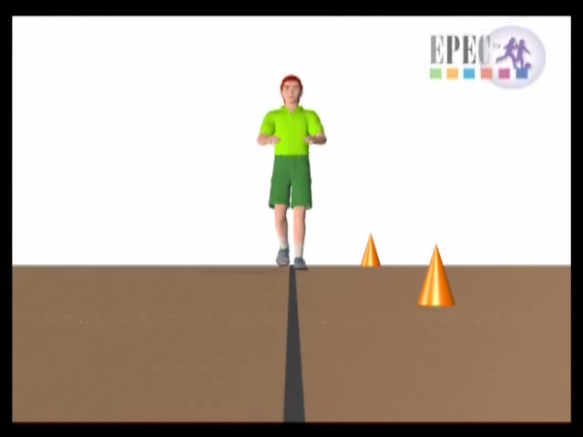
Forward - Gallop

Slide 15
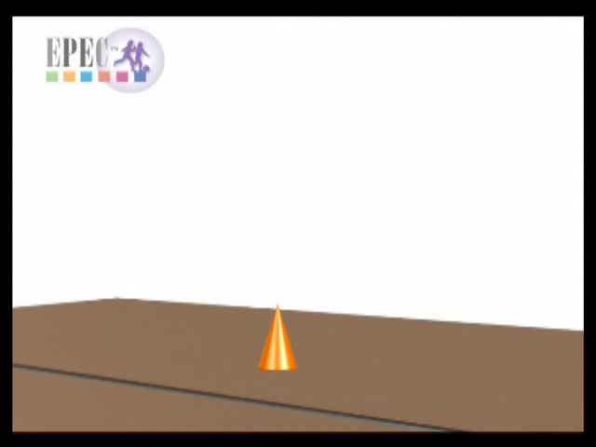
Forward - Skip

Slide 16
Forward Travel
You Pick

Slide 17

Forward Traveling Levels
Notes:
All the traveling should be forward today.

Slide 18
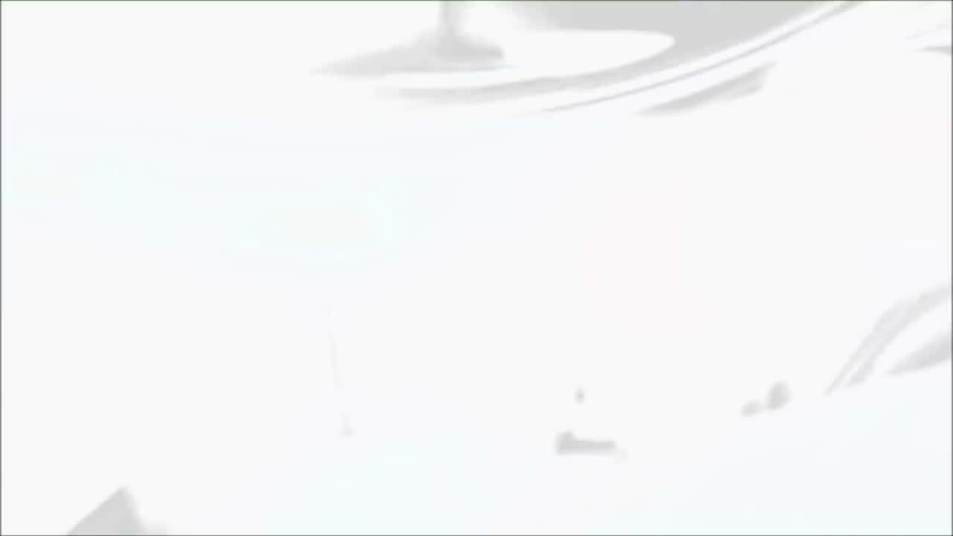
STRETCH

Slide 19
REVIEW
What direction did you travel in today?
Forward
What is the color of this page?
RED!

Slide 20
Good-Bye

