Slide 1

Hello
Stand in an Own Space
Notes:
Get a mat that matches your spot. Put it over your spot and stand on it.

Slide 2
Safe
Notes:
Listen
Look for Open Spaces
Be Aware of others as you travel
Leave the Mats and give everyone a safe high five and say “I’M SAFE!”.

Slide 3

Look, Listen and Go

Slide 4
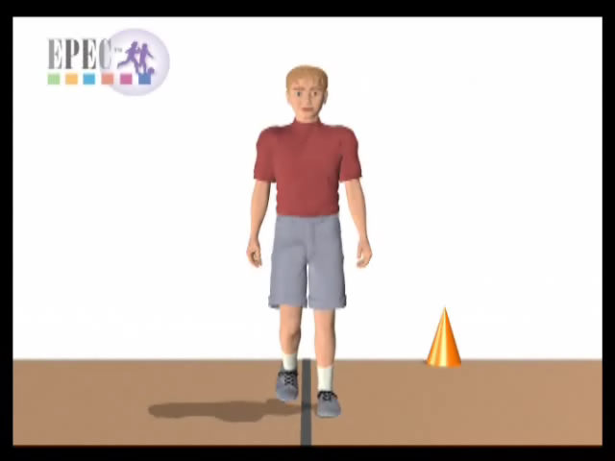
Walk
Notes:
When you travel so the front of your body leads or goes first, it is called “Frontwards or Forward”
What is another way you can travel forward?

Slide 5
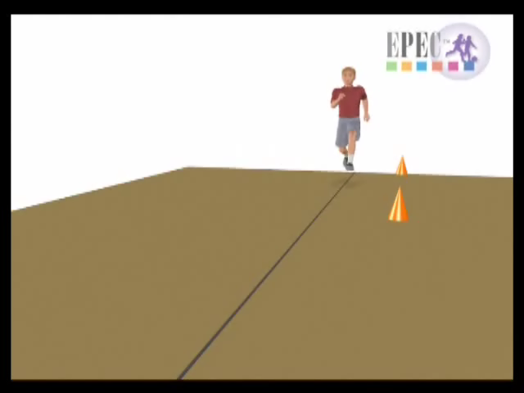
Run

Slide 6
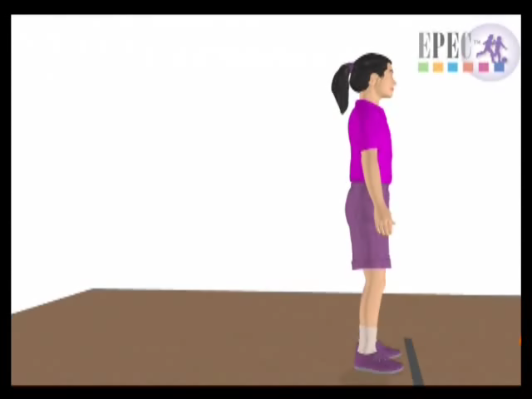
Jump

Slide 7
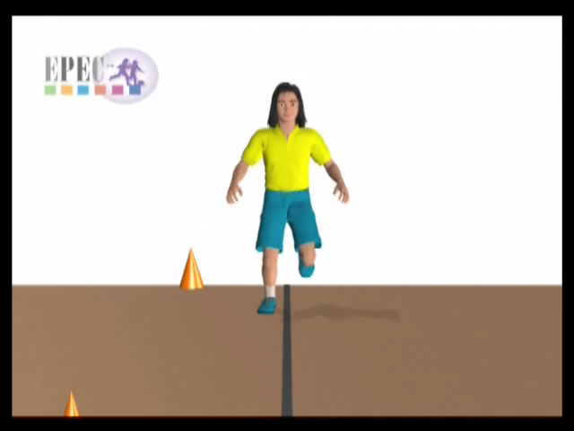
Hop

Slide 8
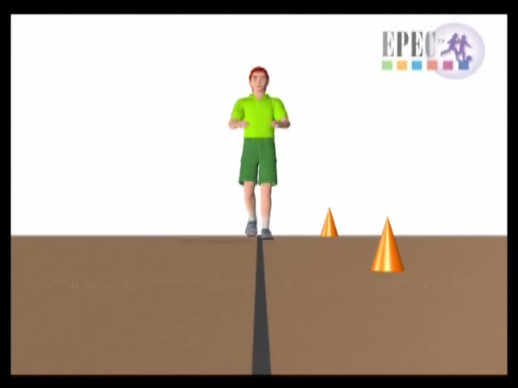
Gallop

Slide 9
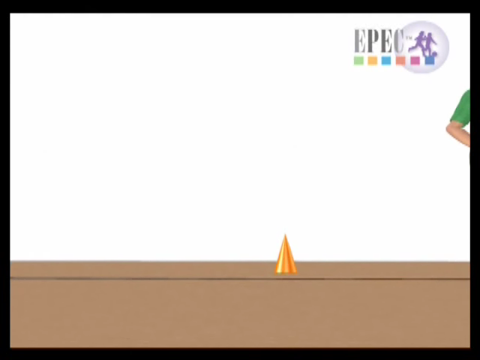
Slide

Slide 10
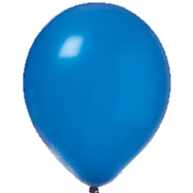
Balloon

Slide 11

Catching the Balloon
Notes:
What do you look at to catch the balloon?

Slide 12


Slide 13
Throw High & Catch
Notes:
What do you look at to catch the balloon?
Where do you put your hands to catch the balloon? (under the balloon as it drops down)

Slide 15
Clap and Catch
Notes:
How many times can you clap before you catch the balloon?

Slide 17
Travel and Catch
Notes:
Where do you have to look as you travel to catch the balloon?
At the balloon and where you are going!

Slide 19
Hit the Balloon
Notes:
Where do you look when you are hitting the balloon?

Slide 21
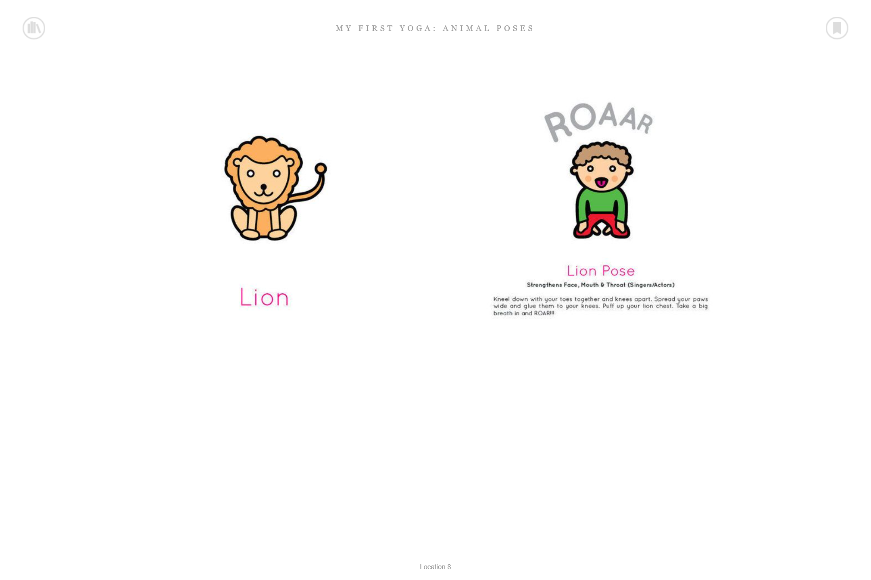
STRETCH

Slide 22
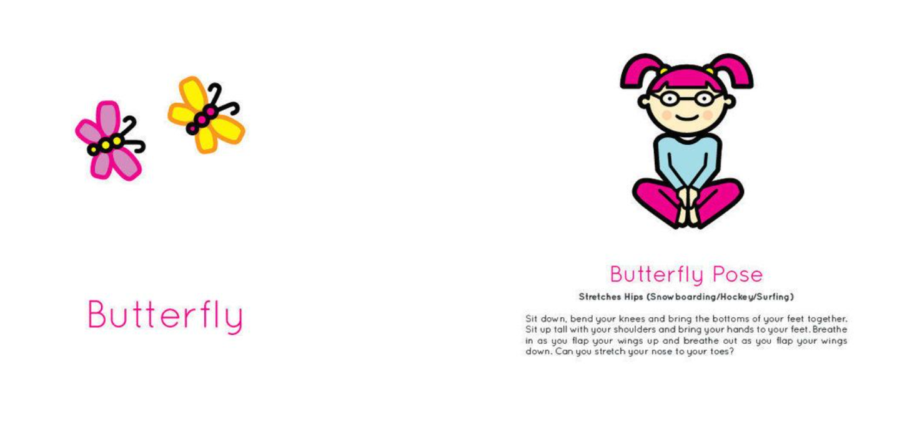
STRETCH

Slide 23
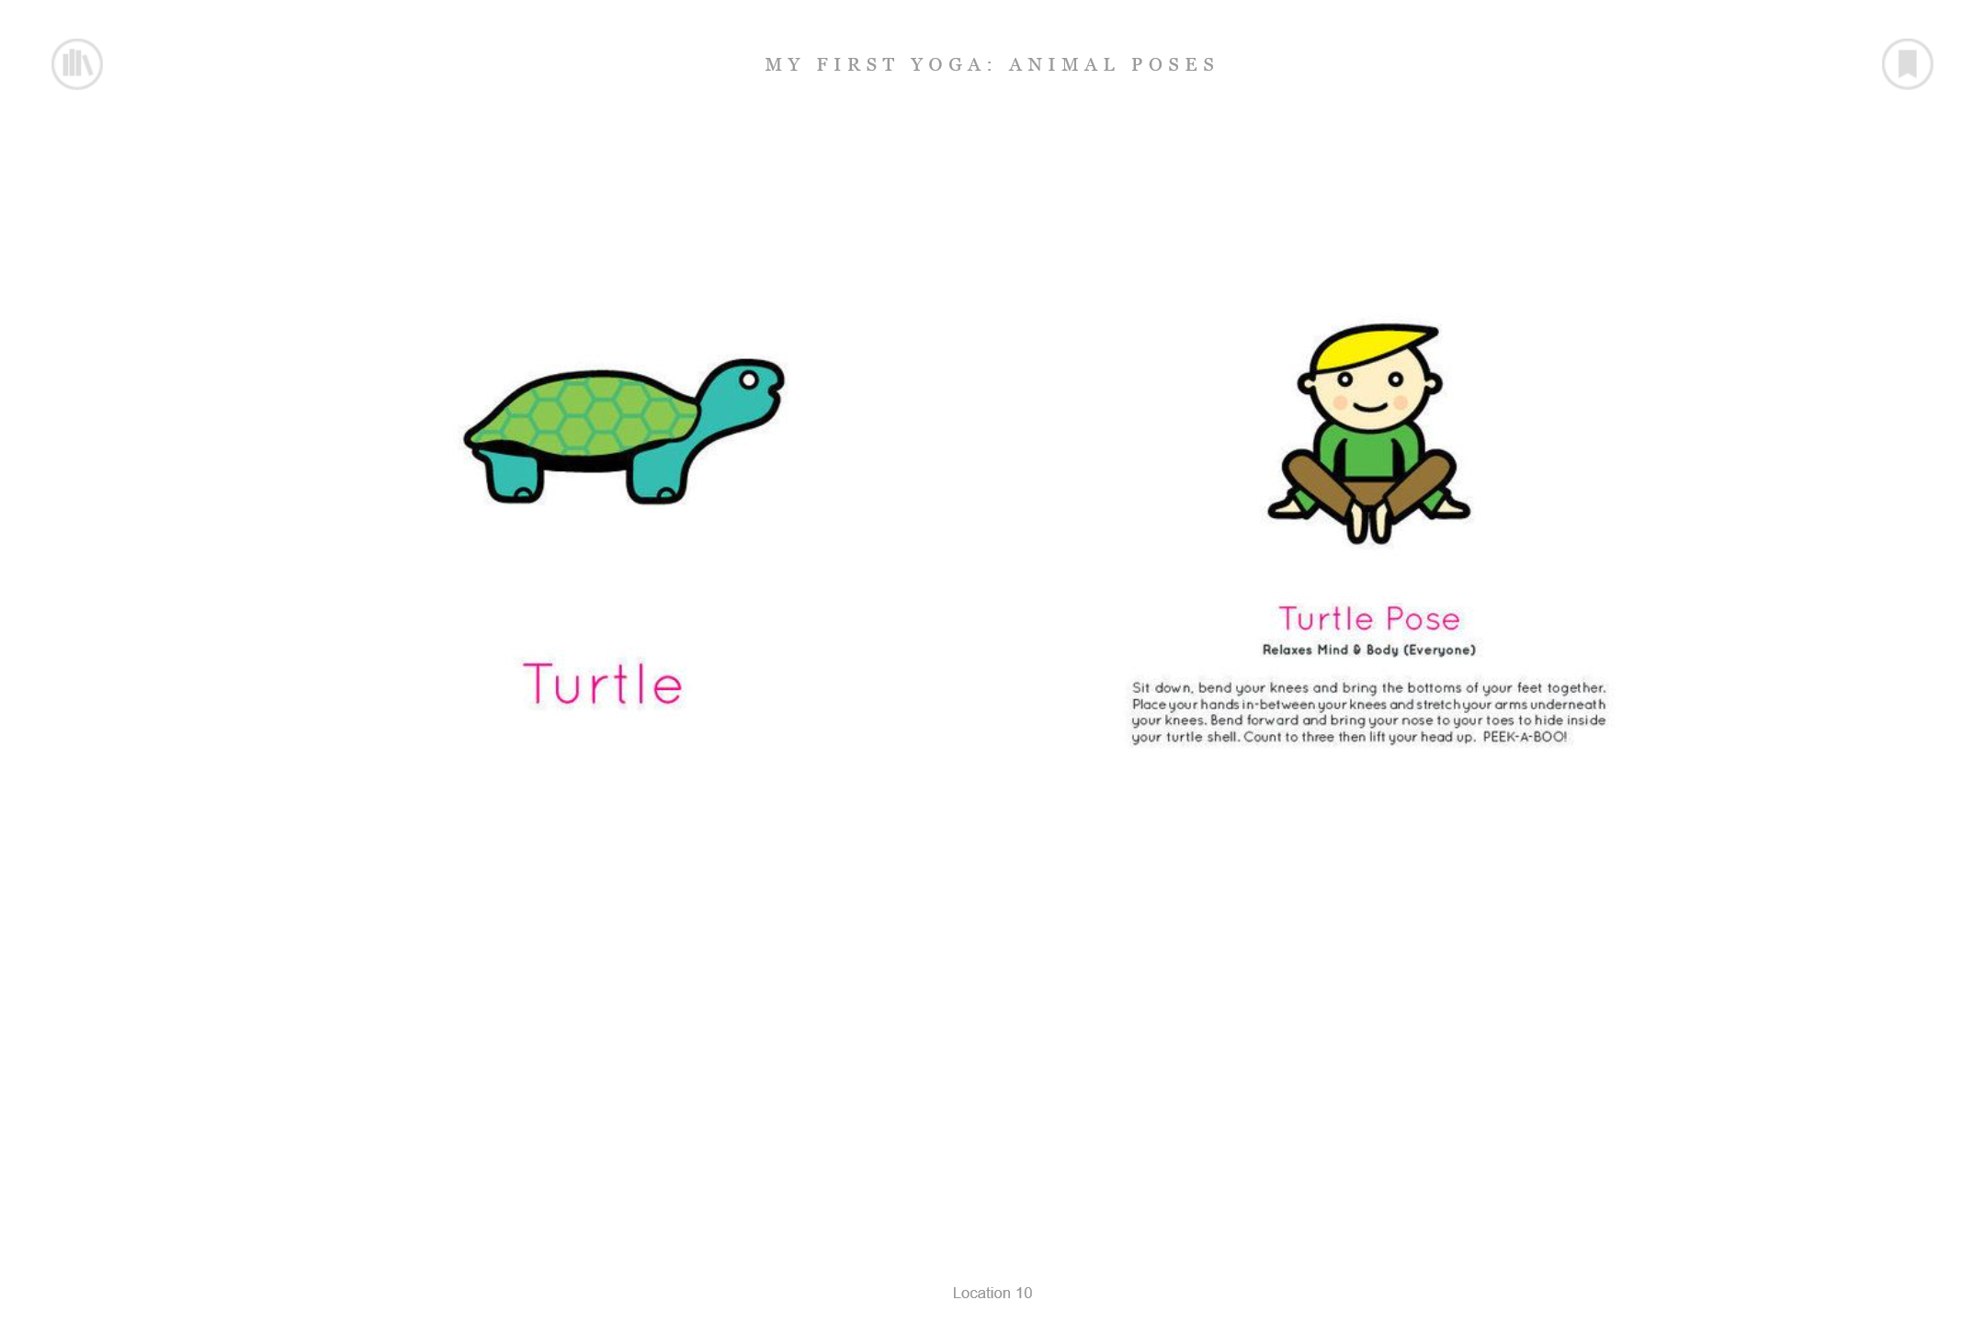
STRETCH

Slide 24
REVIEW
Where do you look when you are catching the balloon?
Where do you look when you are hitting the balloon?
What is the color of this page?
Notes:
What do you look at when you are catching the balloon?
When I hold up the color card, I want you all to say the color name out loud. Ready, (Hold the card up and let the students call out the color.)

Slide 25
Good-Bye

