Slide 1
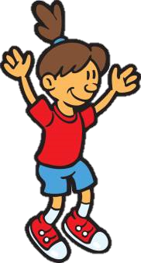
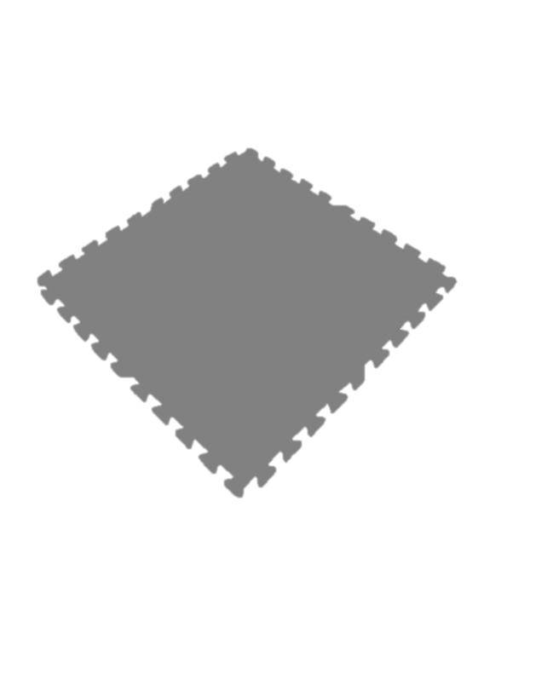
Hello
Get a mat and stand in an own space

Slide 2
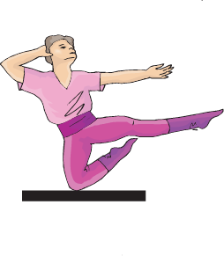
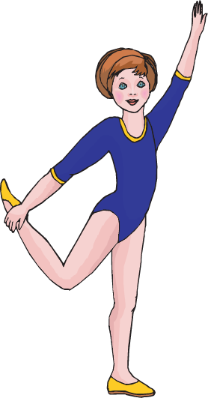
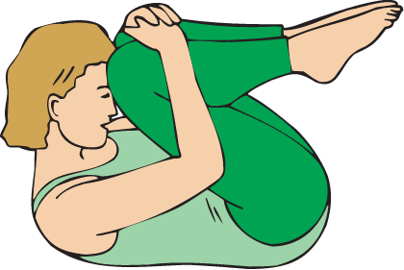
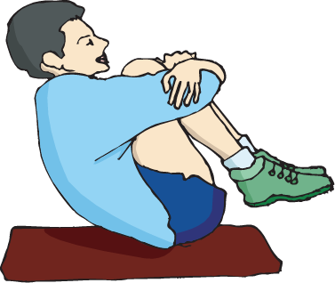
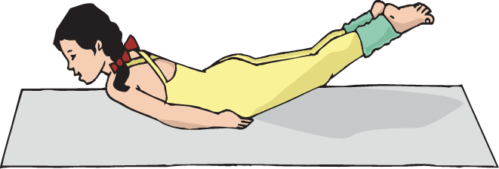
BALANCE TAG
Hold your body still until someone identifies the body part you are balancing on.
Notes:
Play either this game or Travel and Balance to warm up and review body parts and balancing, or weight bearing. Balance Tag is played with flags and the students balance on one body part until a classmate helps them by identifying the body part they are balancing on. If you are identifying a balance, you are safe.
Everyone is it!
If you don’t use this game delete slide #2.

Slide 3

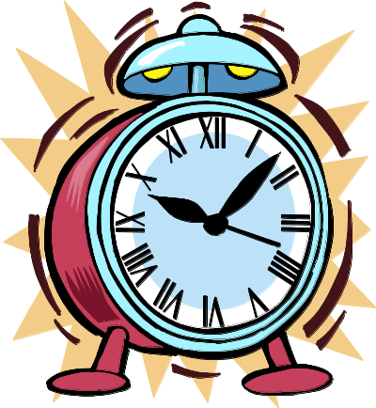
TRAVEL & BALANCE
= Travel
= Balance
Notes:
When the music plays the students will travel. Encourage them to use different levels and directions as they travel. Look for students using the different locomotor moves.
When the music stops, a clock will start ticking. Call out the number of body parts the children will balance on. When the music begins again, the students will begin traveling again. Continue to change the number of body parts the children will balance on when the clock is ticking.
If you don’t do this activity, delete slides #3-#27.

Slide 4



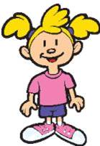
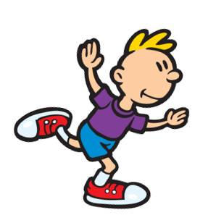
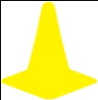
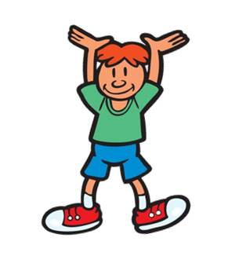

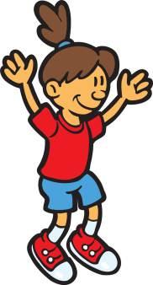
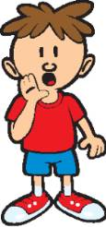
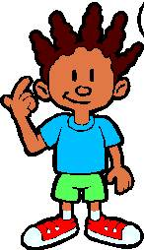
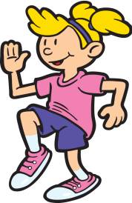
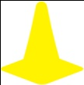


Notes:
Alternate back and forth between this slide and the balance slide. When the music is playing show this travel slide. When the music stops change it to the balance slide. The music will play until the song is over.

Slide 5
Balance on 1 part

Slide 6
Notes:
Alternate back and forth between this slide and the balance slide. When the music is playing show this travel slide. When the music stops change it to the balance slide. The music will play until the song is over.

Slide 7
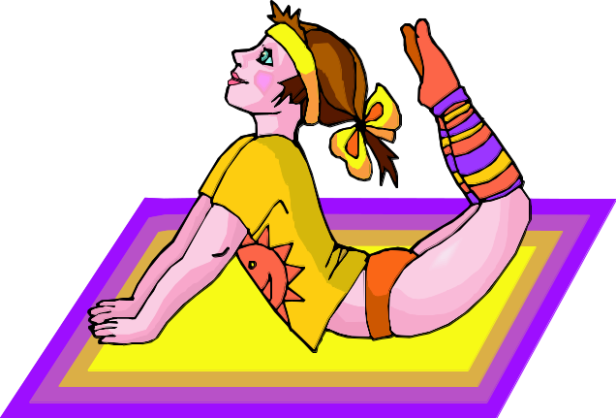
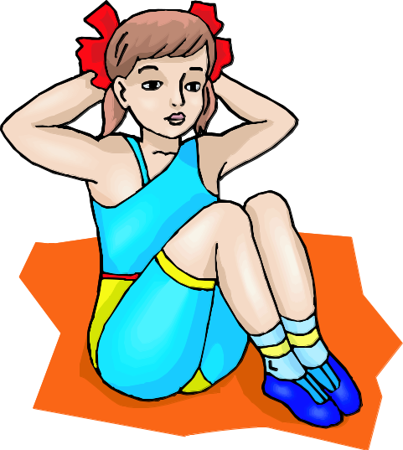
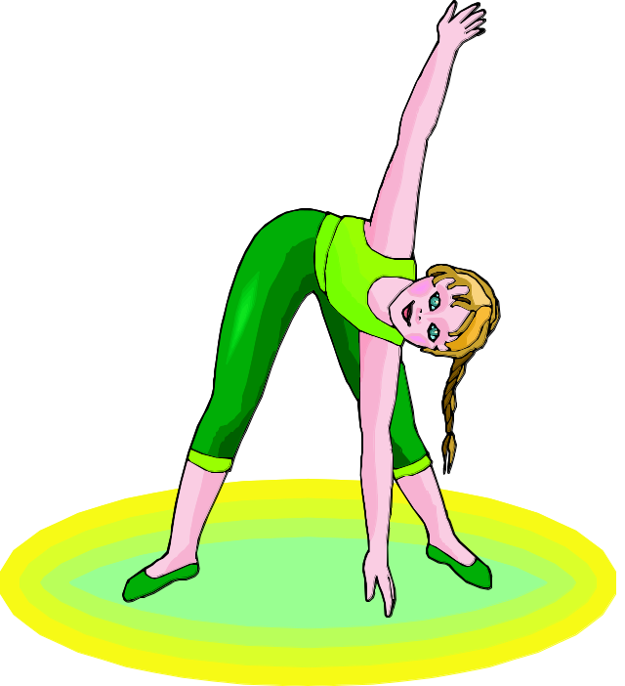
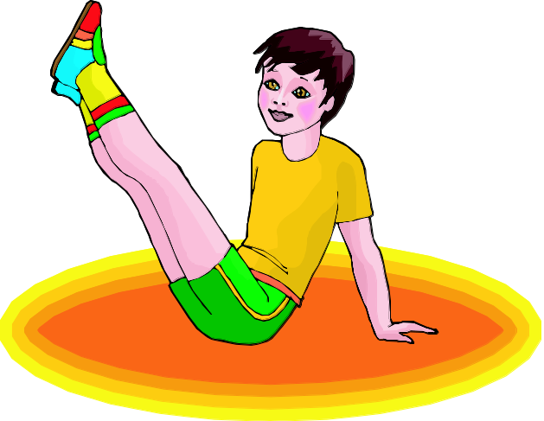
Balance on 3 parts

Slide 8
Notes:
Alternate back and forth between this slide and the balance slide. When the music is playing show this travel slide. When the music stops change it to the balance slide. The music will play until the song is over.

Slide 9
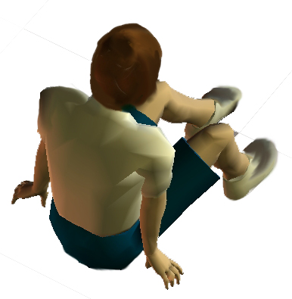
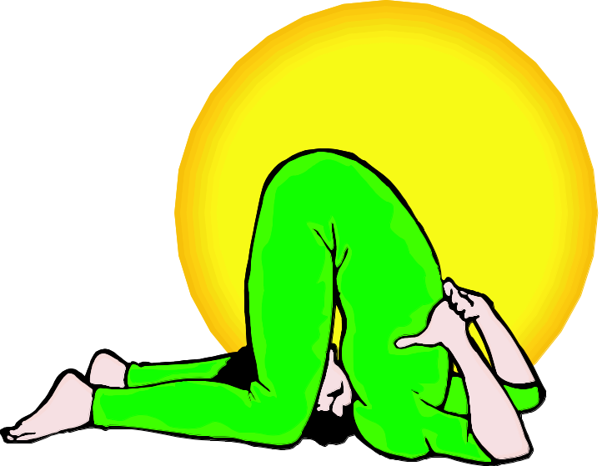
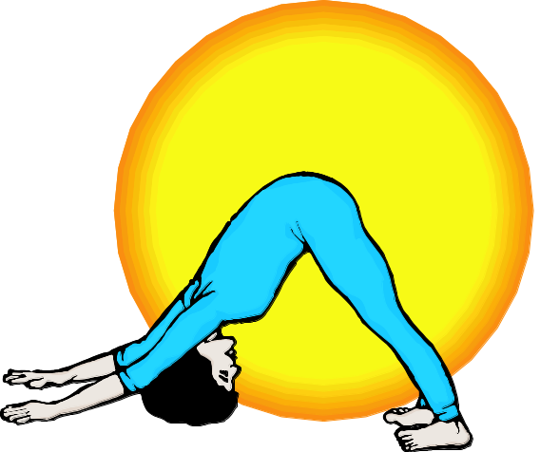
Balance on 5 parts

Slide 10
Notes:
Alternate back and forth between this slide and the balance slide. When the music is playing show this travel slide. When the music stops change it to the balance slide. The music will play until the song is over.

Slide 11
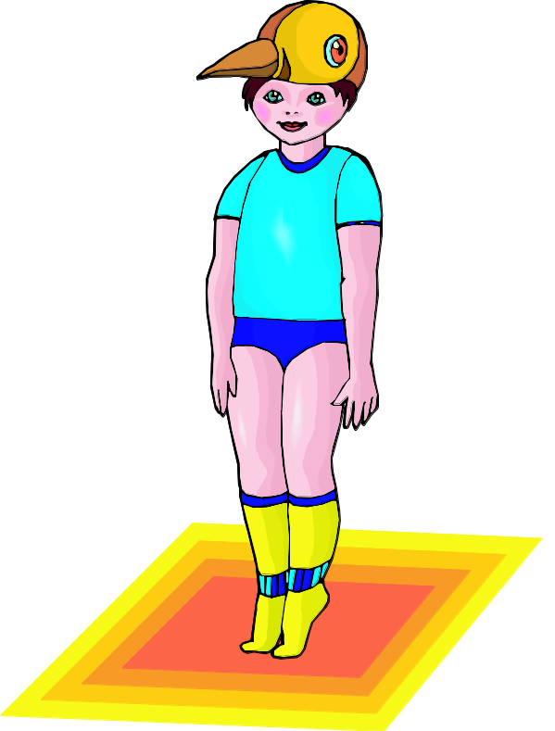
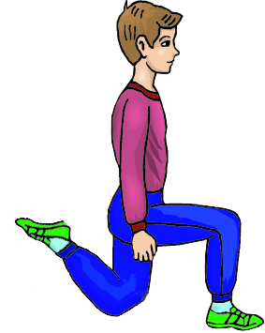
Balance on 2 parts

Slide 12
Notes:
Alternate back and forth between this slide and the balance slide. When the music is playing show this travel slide. When the music stops change it to the balance slide. The music will play until the song is over.

Slide 13
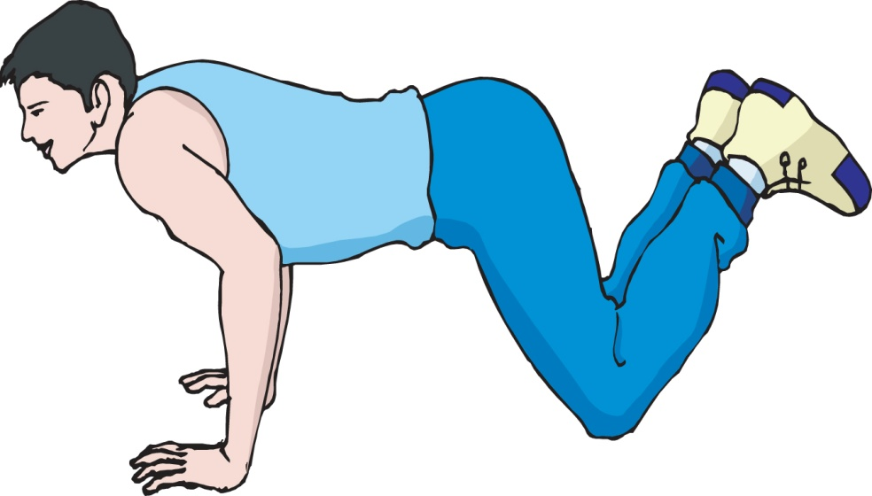
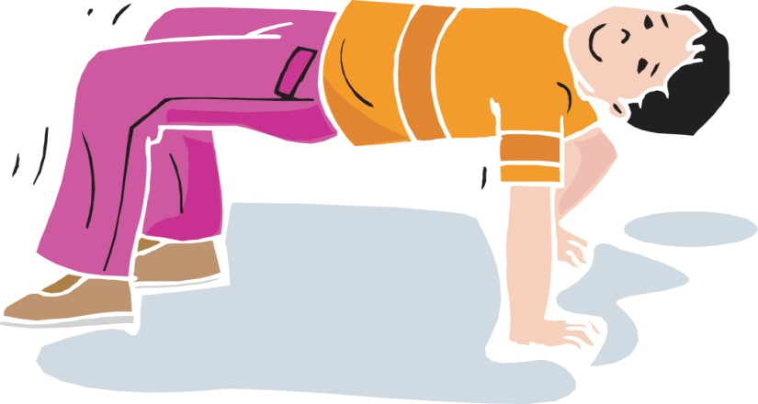
Balance on 4 parts

Slide 14
Notes:
Alternate back and forth between this slide and the balance slide. When the music is playing show this travel slide. When the music stops change it to the balance slide. The music will play until the song is over.

Slide 15
Balance on 1 part

Slide 16
Notes:
Alternate back and forth between this slide and the balance slide. When the music is playing show this travel slide. When the music stops change it to the balance slide. The music will play until the song is over.

Slide 17
Balance on 3 parts

Slide 18
Notes:
Alternate back and forth between this slide and the balance slide. When the music is playing show this travel slide. When the music stops change it to the balance slide. The music will play until the song is over.

Slide 19
Balance on 5 parts

Slide 20
Notes:
Alternate back and forth between this slide and the balance slide. When the music is playing show this travel slide. When the music stops change it to the balance slide. The music will play until the song is over.

Slide 21
Balance on 2 parts

Slide 22
Notes:
Alternate back and forth between this slide and the balance slide. When the music is playing show this travel slide. When the music stops change it to the balance slide. The music will play until the song is over.

Slide 23
Balance on 4 parts

Slide 24
Notes:
Alternate back and forth between this slide and the balance slide. When the music is playing show this travel slide. When the music stops change it to the balance slide. The music will play until the song is over.

Slide 25
Balance on 3 parts

Slide 26
Notes:
Alternate back and forth between this slide and the balance slide. When the music is playing show this travel slide. When the music stops change it to the balance slide. The music will play until the song is over.

Slide 27
Balance on 2 parts

Slide 28
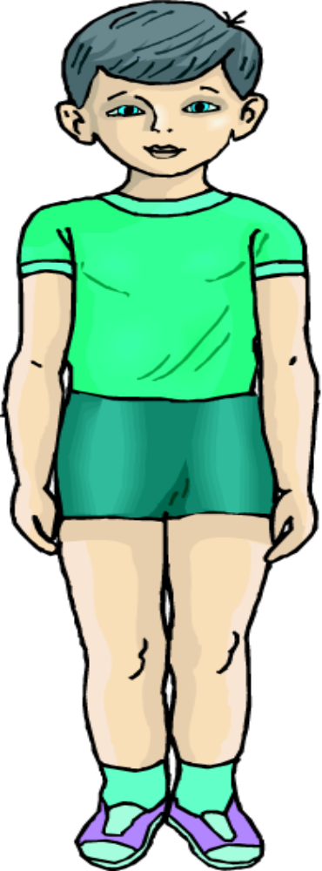
FRONT
FACE
CHEST
PECTORALIS
STOMACH
ABDOMEN
THIGH
QUADRICEP
KNEE
PATELLA
SHIN
TIBIALIS
TOES
PHILANGES

Slide 29
BACK
HEAD
BACK
TRAPEZIUS
SEAT
GLUTEUS
THIGH
HAMSTRING
CALF
HEEL
Notes:
Back surface

Slide 30
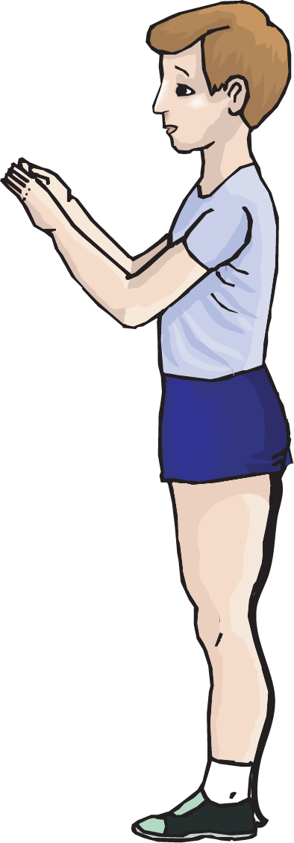
SIDE
EAR
SHOULDER
DELTOID
WAIST
HIP
ANKLE
Notes:
SIDE SURFACE

Slide 31
Weight Transference
Notes:
Moving or changing the body parts holding your weight. Demonstrate a simple transfer of weight. Foot to foot, or walking!

Slide 32
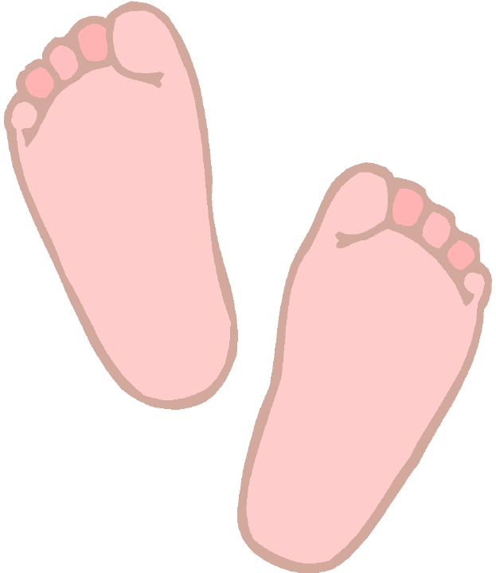
High level
Weight on two feet

Slide 33
Smoothly Transfer your weight to your gluteus.

Slide 34
Smoothly transfer your weight to your back.

Slide 35
Without stopping;
High level – weight on two feet
Change to medium level, transfer weight to gluteus.
Transfer weight to back.
Notes:
Do it again, all in a row, nice and smooth transition between body parts.

Slide 36
Rocking
Transferring weight back and forth between two or more body parts

Slide 37
Rocking - Back Surface
Smoothly transfer your weight by rocking:
from your two feet,
to gluteus,
to back
to shoulders
then reverse:
back, gluteus then feet.

Slide 38
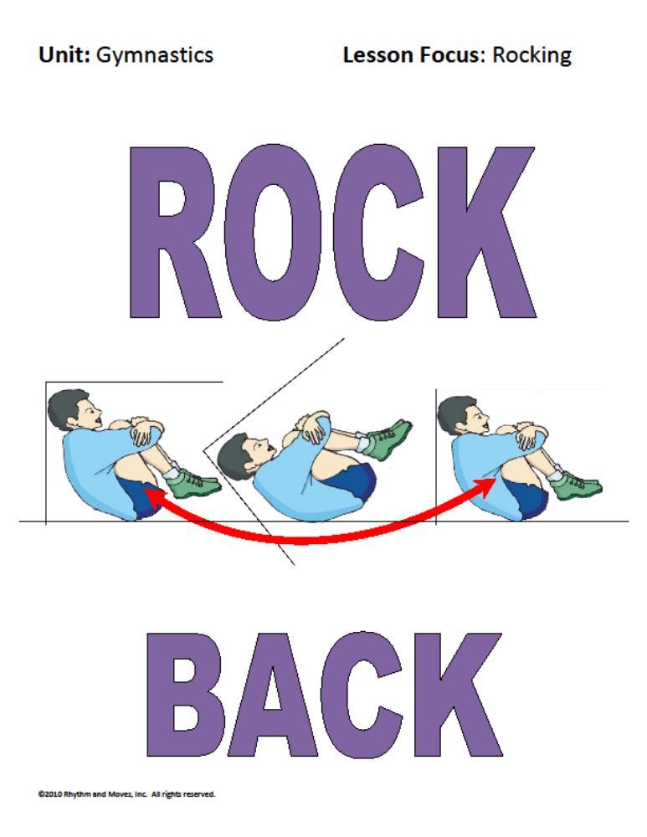

Slide 39
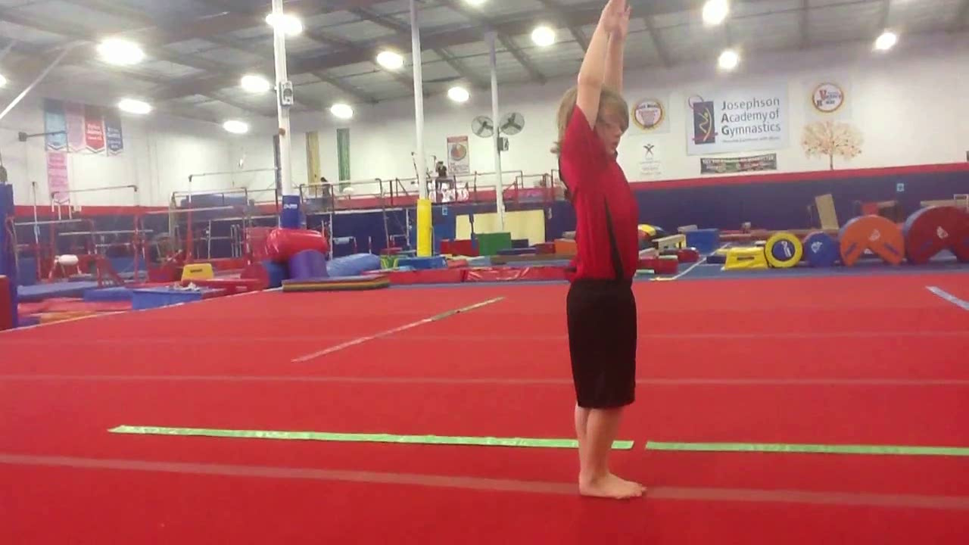
Rocking - Back Surface

Slide 40
Rocking - Front Surface
Take your weight on your stomach.
Smoothly transfer your weight between your chest, stomach and quadriceps.

Slide 41
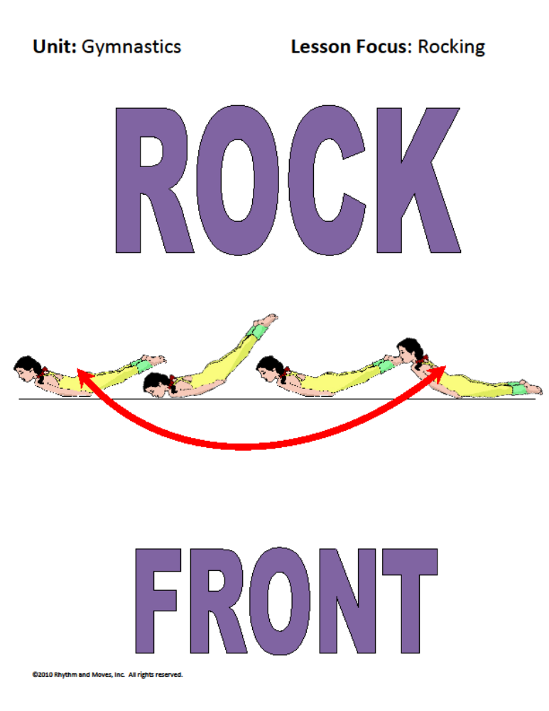

Slide 42
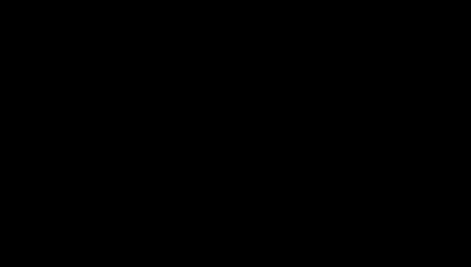
Rocking - Front Surface

Slide 43
Rocking - Side Surface
Take your weight on your hip.
Smoothly transfer your weight between your hip, leg and waist.

Slide 44
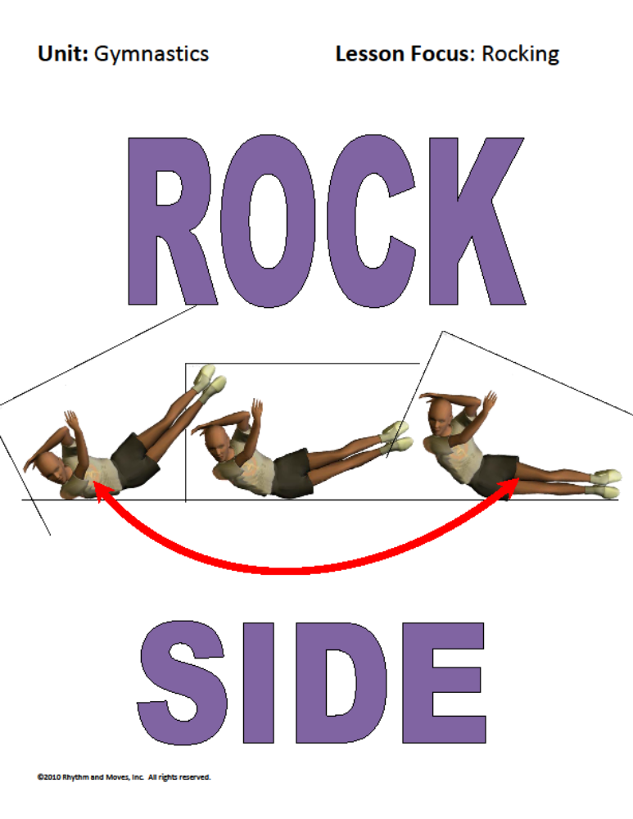

Slide 45
Rocking Sequence
Rock along your back surface.
Smoothly change surfaces to rock along your side surface
Smoothly change surfaces to rock on your back surface

Slide 46
Rocking Sequence
Rock along your front surface.
Smoothly change surfaces to rock along your side surface
Smoothly change surfaces to rock on your front surface

Slide 47
Rocking Sequence
Rock along your back surface.
Smoothly change surfaces to rock along your side surface
Smoothly change surfaces to rock on your front surface

Slide 48
Rocking
Create a rocking movement between two or more body parts?

Slide 49
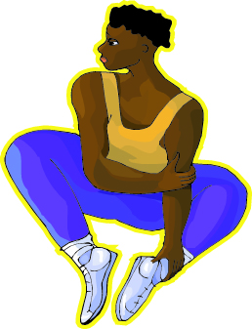
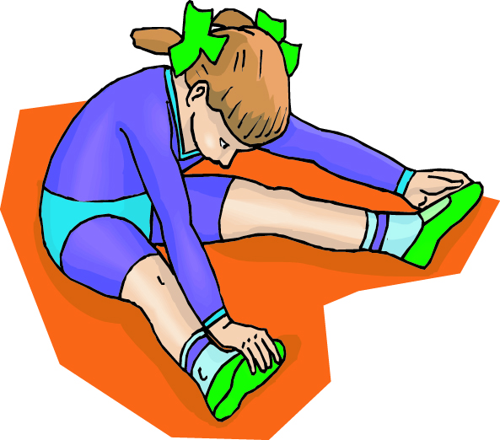
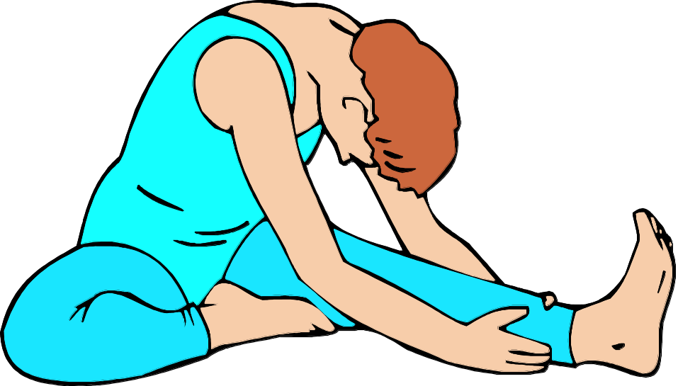
STRETCH

Slide 50
Closure
What body surfaces did you rock along today?
What is rocking?

